Slide 1
CREATING NEW USERS AND WALKLISTS
Notes:
This presentation will familiarize you with the processes for creating new user accounts, creating teams of users and cutting walklists.

Slide 2
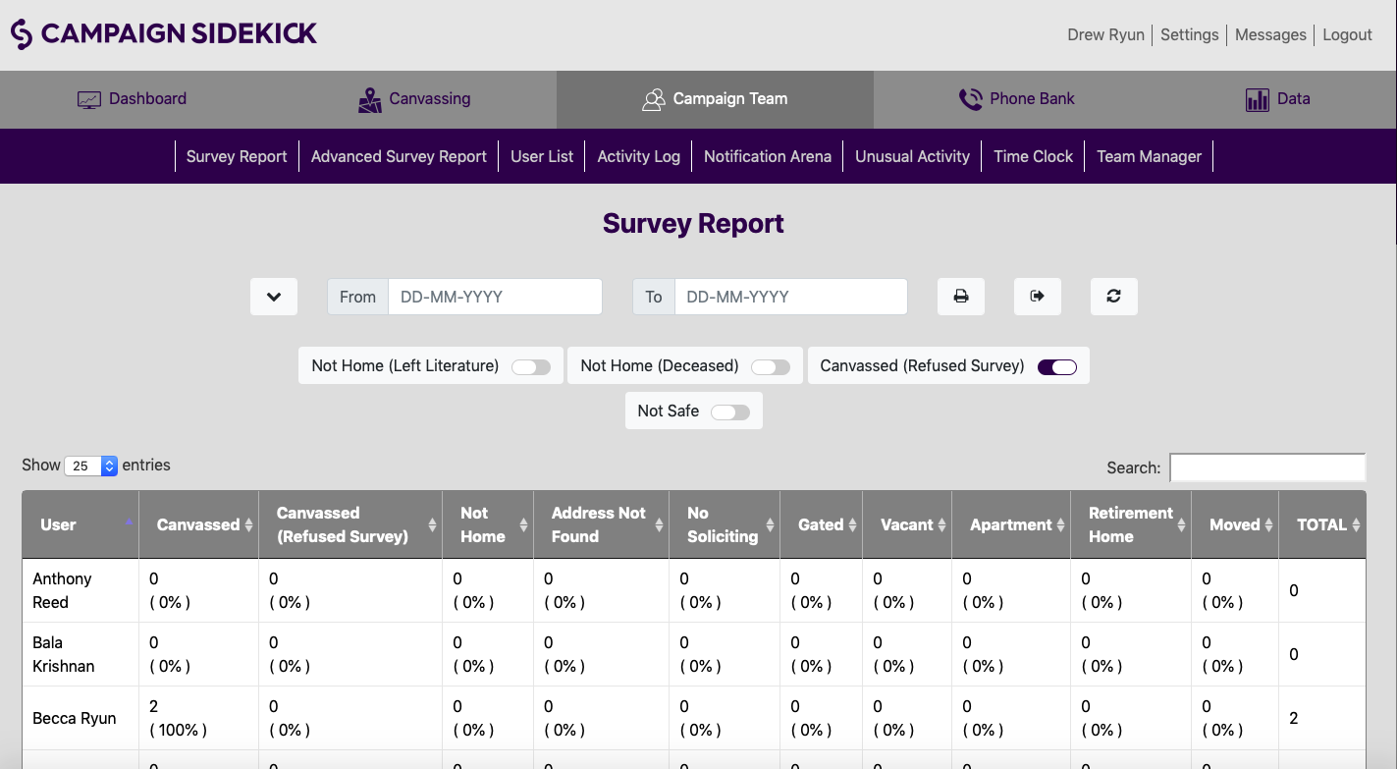
CREATING NEW USER
To add a new user to your campaign, navigate to the “Campaign Team” tab and then select the “User List” sub-menu option.
Notes:
The Campaign Team Tab is where you will conduct user creation, team management, walker tracking and much of your survey reporting. In this presentation, we will focus our activity on this tab to creation of new users.

Slide 3
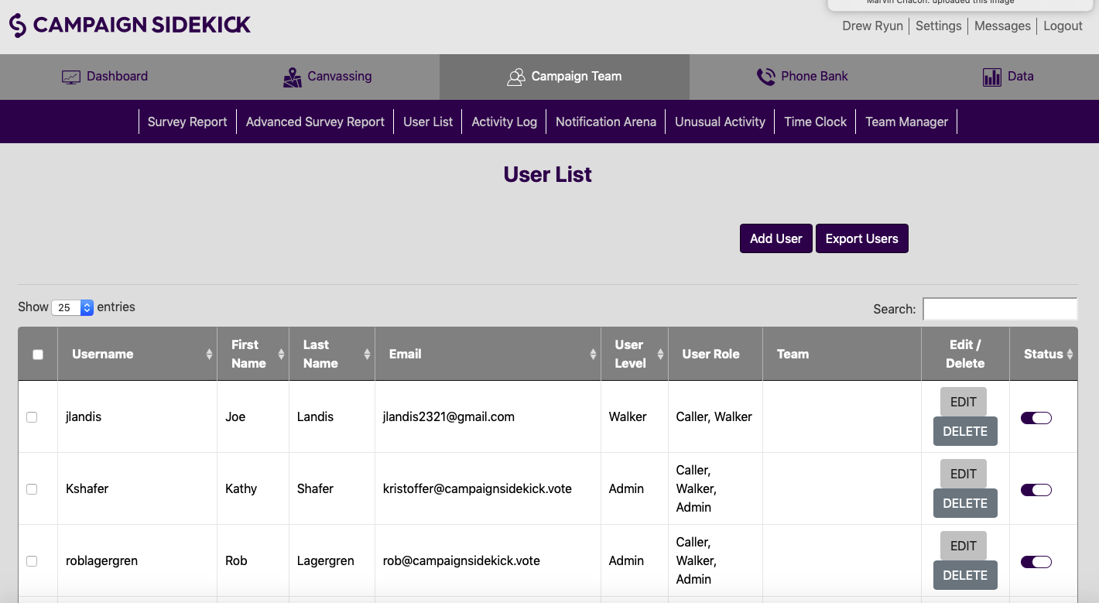
CREATING NEW USER
To create a new user account or upload a list of new users, select the Add User button to begin creating a new account.
Notes:
The User List page is where you will manage existing user accounts. Depending on your permission level, you may be able to create, edit, delete and turn off/on individual accounts. To create a new user or upload a new list of users, click “Add User.”

Slide 4
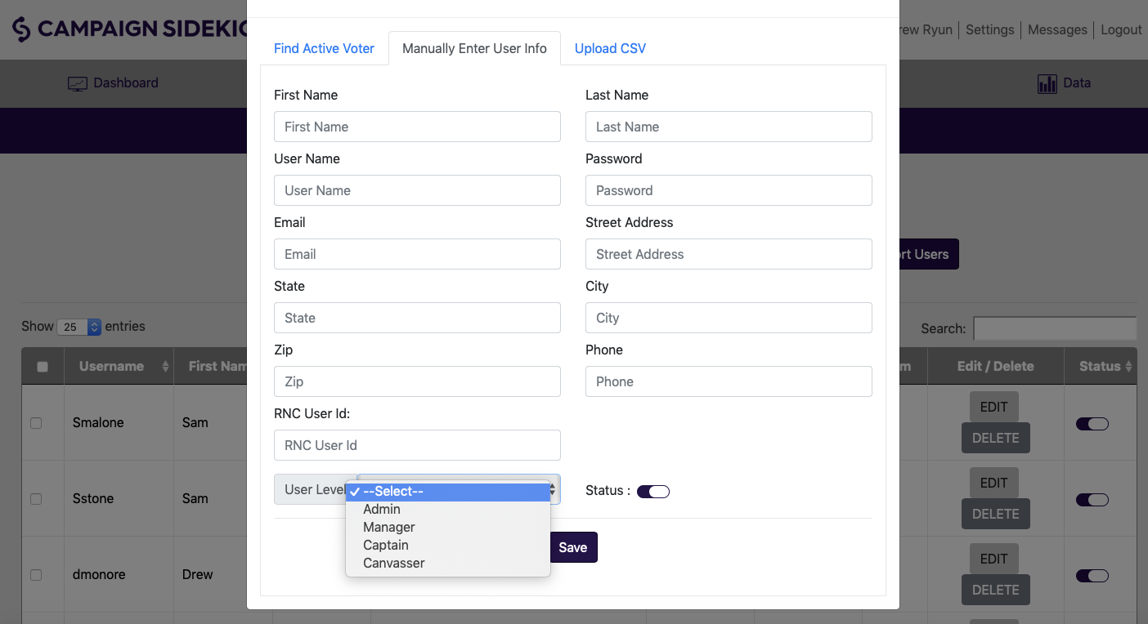
PERMISSION LEVELS
We now have 5 permission levels
Account Owner: Account Owners have no restrictions to their CampaignSidekick account.
The others are:
Admin
Manager
Captain
Canvasser
Notes:
The next level down is Admin. Admin has the capability to do 95% of what an Account Owner can, but tied to the permissions the Account Owner wants to give them (see second screen shot). If an Account Owner chooses, an Admin can do everything in their CampaignSidekick account except for constrained abilities in the Settings.

Slide 5
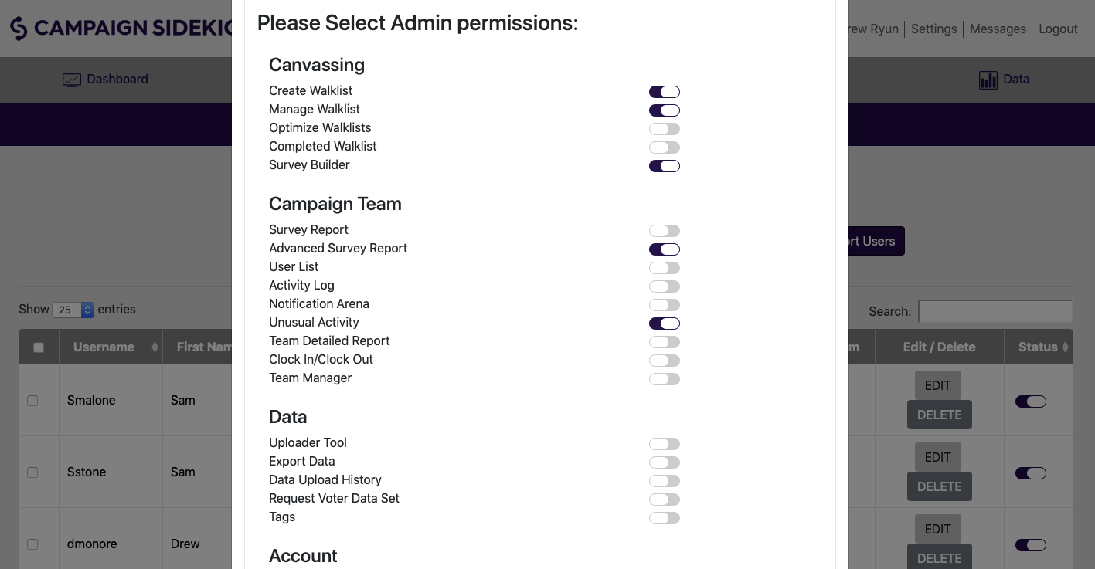
PERMISSION LEVELS-Admin
Admin: Has the capability to do 95% of what an Account owner can, but tied to the permissions the Account Owner wants to give them. Account Owners can create even different levels of Admin using the toggle functions to give Admins use of various functions in CampaignSidekick.

Slide 6
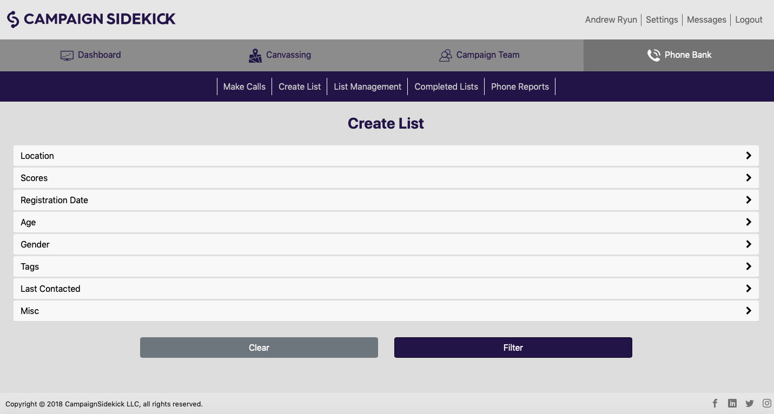
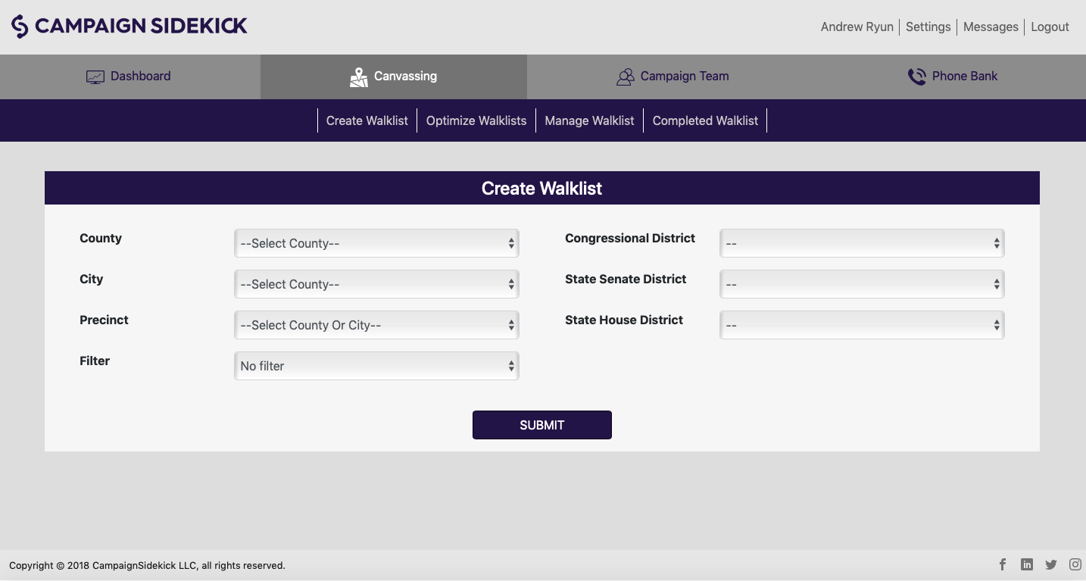
PERMISSION LEVELS-Managers
A Manager is constrained to creating and assigning walk lists, assigning phone lists, and adding new users
They cannot create voter universes or surveys and have no settings access.
They may also add other captains and canvassers and create teams.

Slide 7
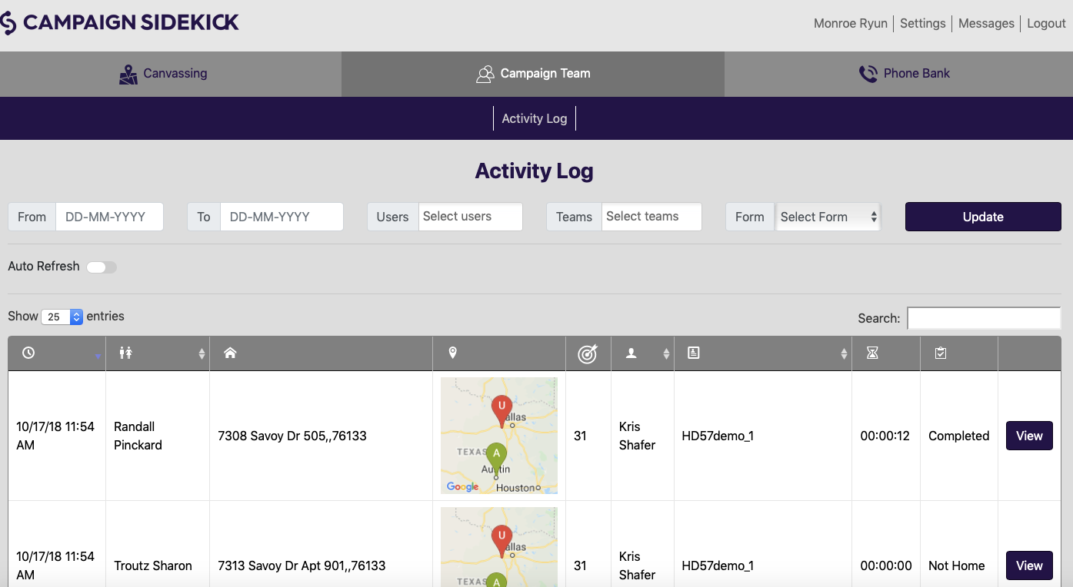
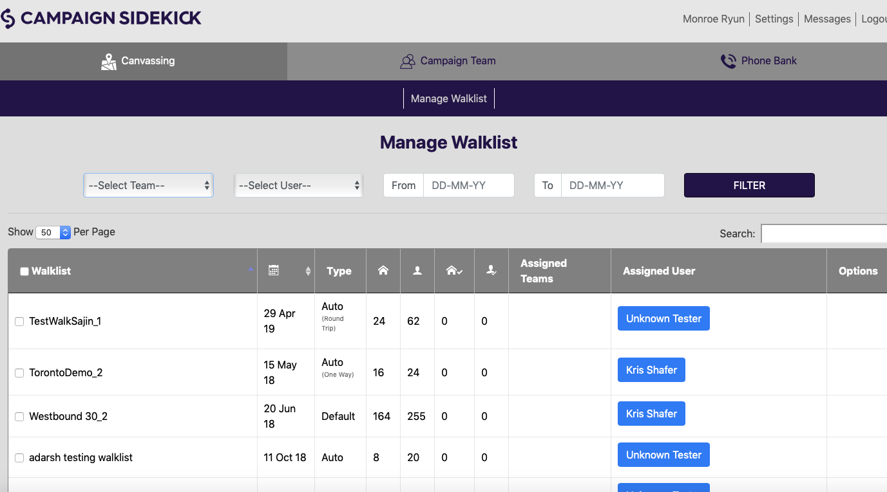
PERMISSION LEVELS-Captains & Canvassers
A Captain can assign both walk and phone lists, create teams and add new Canvassers.
They will have no settings access and cannot create walklists, phonelists or surveys.
Canvassers may log in to CampaignSidekick through a desktop or laptop to make phone calls and or may use the app to make calls or knock on doors.

Slide 8
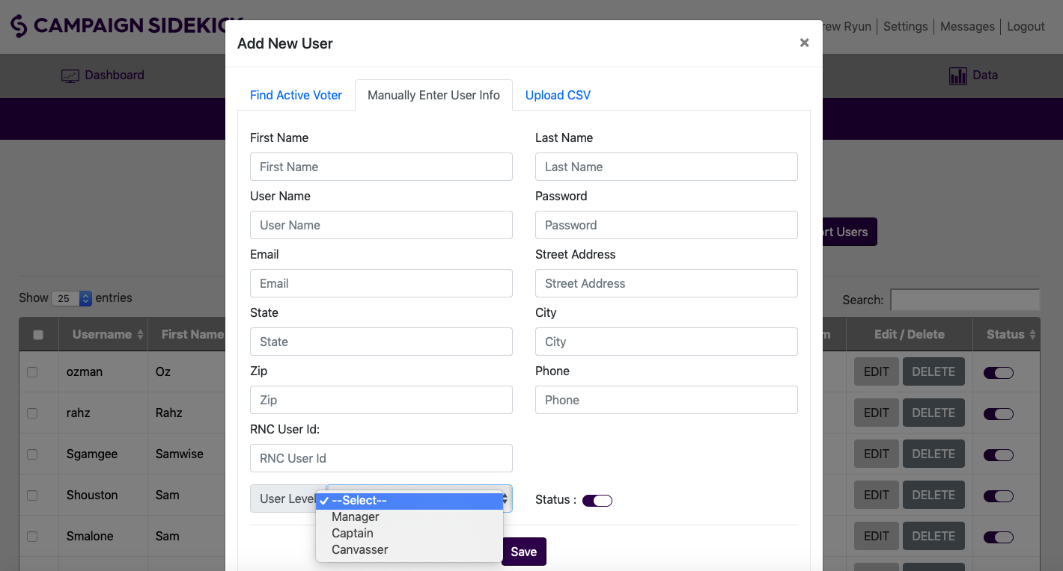
CREATING NEW USER
Three Options for creating new users:
Find Active Voter: Search for a voter profile and tie a users activity to that voter’s Sidekick profile.
Manually Enter Voter Info: Current view. Most users are created this way.
Upload CSV: Use the example CSV to format and upload a list of accounts you wish to create.
Notes:
Using the Upload CSV option is a great way to save time when creating a large number of users. Download the sample CSV, input your user information and upload to create user accounts in large numbers.
The Find Active Voter option allows you to search within the voters in your database to tie a volunteer’s activity to their user account.
If you are adding a few volunteers at a time, select “Manually Enter User Info.” Then fill out your fields, select their Level and Role then Save.
If you have done this correctly, you will see a “Success!” message from CampaignSidekick. You have now added a new user to your Sidekick account!

Slide 9
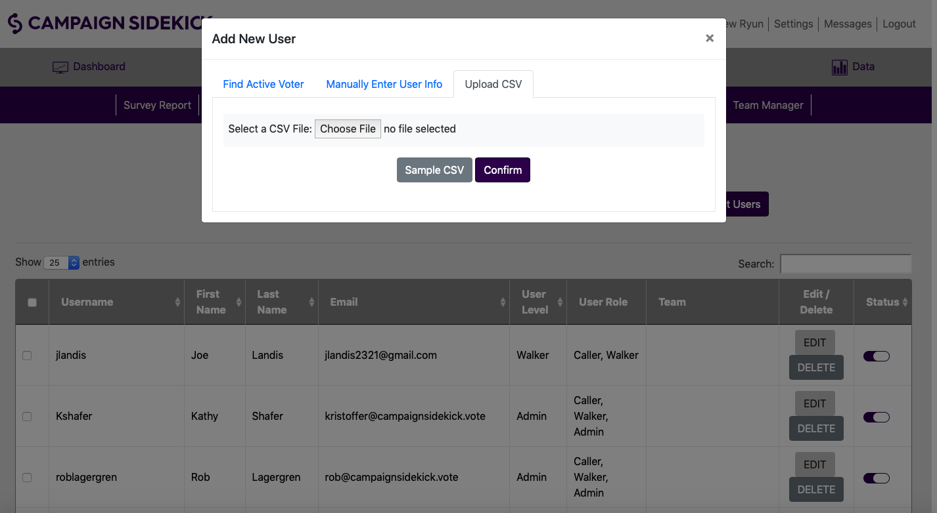
CREATING NEW USER: CSV Upload
With a CSV, you can load an entire file, up to thousands of users at a time, of volunteers or admin level users.
Make sure you click on “Sample File” first. Sidekick will download a template for you. Follow it! Then, name your file, then select “Choose File” then “Confirm.”
You have now added your new users and may start assigning them walk and phone lists!
Notes:
If you’re creating more than a few users at a time, uploading users via this bulk file option may be a tool you should consider. It’s easy to format volunteer lists into the upload format and create many at a time!

Slide 10
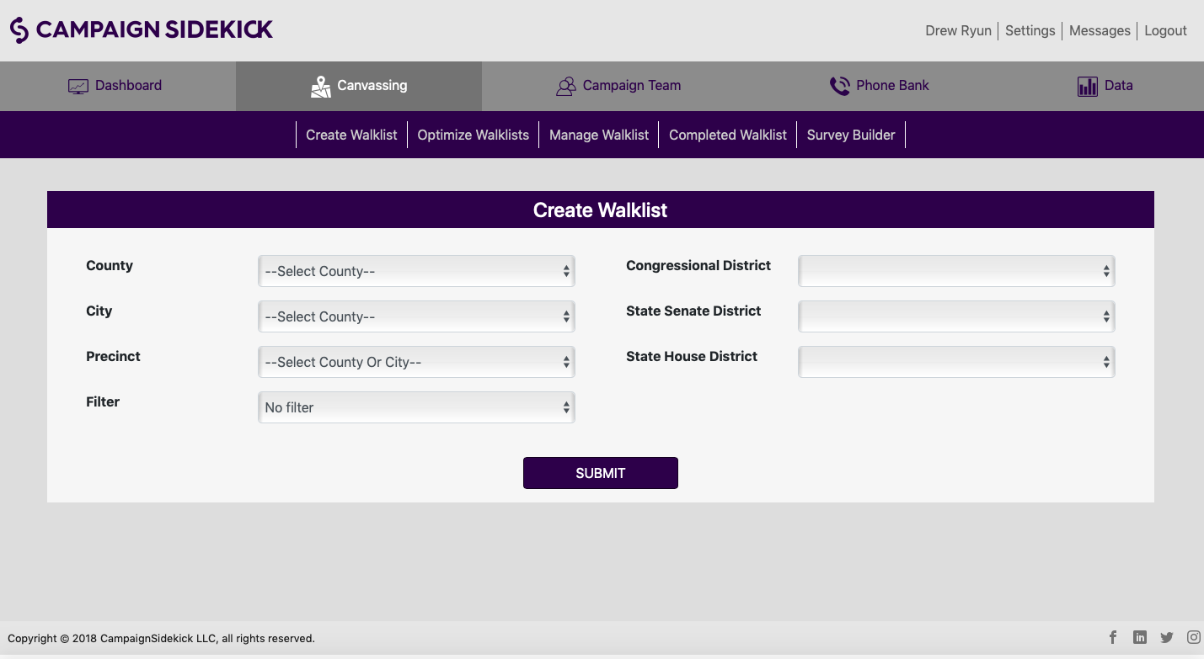
CREATING WALKLISTS
To create walklists, first navigate to the Canvassing tab, where the Create Walklist page will appear.
Next, select the geographic area you want to display on the map and cut lists.
If your campaign is using a pre-set filter, select it from the Filter dropdown. Then click the Submit button.
Notes:
To begin the walklist creation process, you need to first select the geographic area that you want to display on the map and cut lists from. You can select a legislative district or drill down through County, City and Precinct. You must select at least one option to load the map (such as a legislative district or county). Selecting options for City and Precinct are optional.
Pre-Set filters are highly recommended for campaigns. They allow campaign leadership to define a universe and remove opportunity for field staff to use the wrong filters when creating walklists.

Slide 11
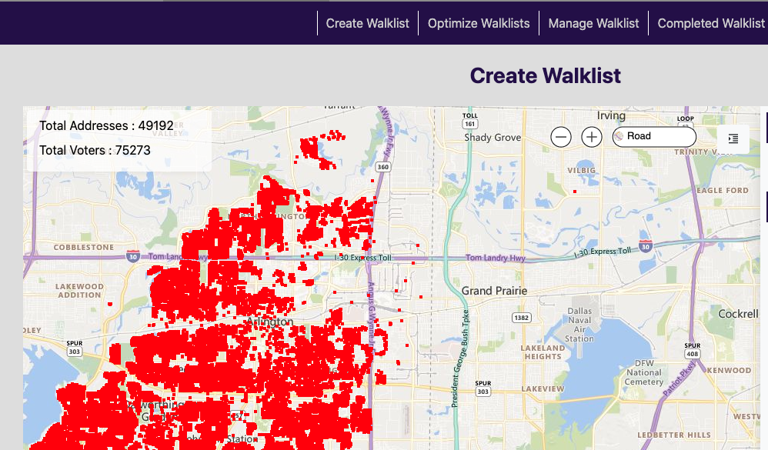
CREATING WALKLISTS
When the map loads, you will see colored dots on the map, representing all households within the parameters you set on the previous screen. Household and voter count will display in the top-left corner of the screen.
Open the slider on the right to adjust filters or begin cutting walklists.
Notes:
Upon loading, the map will display all households within the geographic bounds (and filter if you selected a pre-set filter option) you set on the map as colored dots. Red dots are households that are not currently in active walklists. Dots of other colors are in active walklists. The counts in the top-left corner of the screen will display household/voter numbers for all houses within the map view. Once you begin cutting walklist polygons, this number will show you the number of households/voters within the bounds of the polygon.
On the right hand side of the screen is a slider (accessible by the arrow tab) that will display your options for setting/change filter settings and creating/saving walklists. When filters are changed, you must click the “Update Plotting” button in order to refresh the counts and map display.

Slide 12
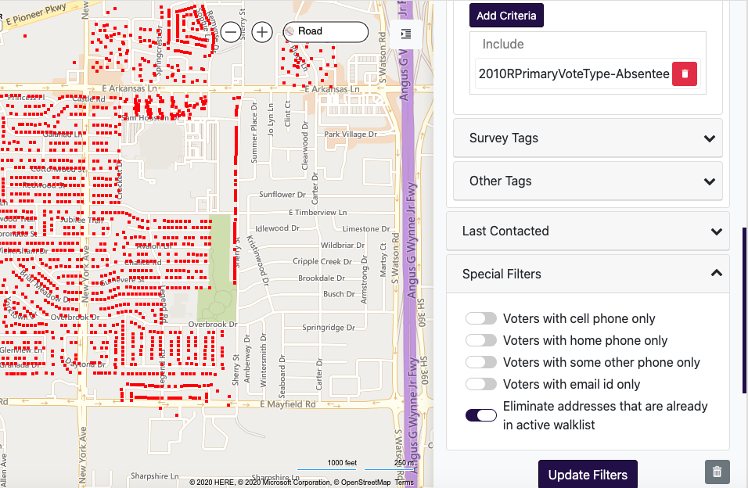
CREATING WALKLISTS
Via the slider on the right, administrators have a variety of powerful filters to select a precise universe of voters.
Once you select your tags, remember to click “Add Tag Criteria,” then click “Update Filters” to refresh the map view and voter counts.
Notes:
The filters that CampaignSidekick offers allow you to carefully define your voter universe. From simple R-Score filters to demographic information and a variety of tagging options, everything you need to specifically target your ideal universe is at your fingertips. Election Tags allow you to target based on a voters past voting history. Survey Tags are created based on survey responses from within the CampaignSidekick app. “Other Tags” are tags such as demographic information and other information gathered outside of CampaignSidekick and uploaded to the system.
These tags can be applied to filter voters based on a variety of logic options. And/Or logic and include/exclude are the most commonly used options.

Slide 13
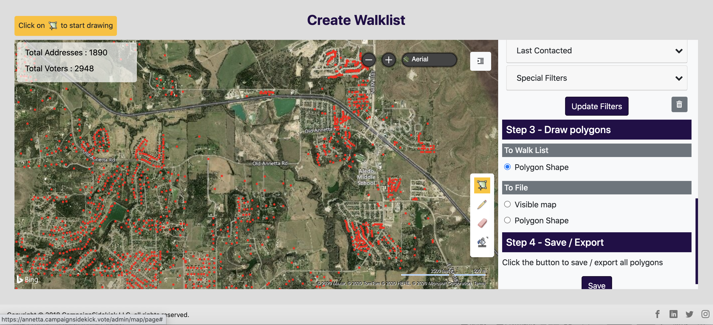
CREATING WALKLISTS
When your voter universe is set, scroll to “Step 3” in the right-side slider. Select the Polygon Shape option and then click the Polygon icon to define the bounds of your walklist.
After you have clicked the Polygon icon, move over to the map and click with your cursour, then drag, click again and repeat until you have the size walklist you want. To complete the polygon shape (walklist), hit your ESC key.
Notes:
Two types of walklists can be created: Lists of 25 or less households will require computer route optimization before they are available to walk. This is a simple step that we will describe in a few slides. These types of lists are ideal for offline app walking or printed walklists. You will be able to operate from the map view in the app or view turn-by-turn directions in the list view.
Lists of above 26-150 houses do not require optimization. The preferred way to walk those lists is from the map view, where users can easily orient themselves based on their GPS position and the relative proximity and direction of target households.
You can create up to 10 walklists at a time.

Slide 14
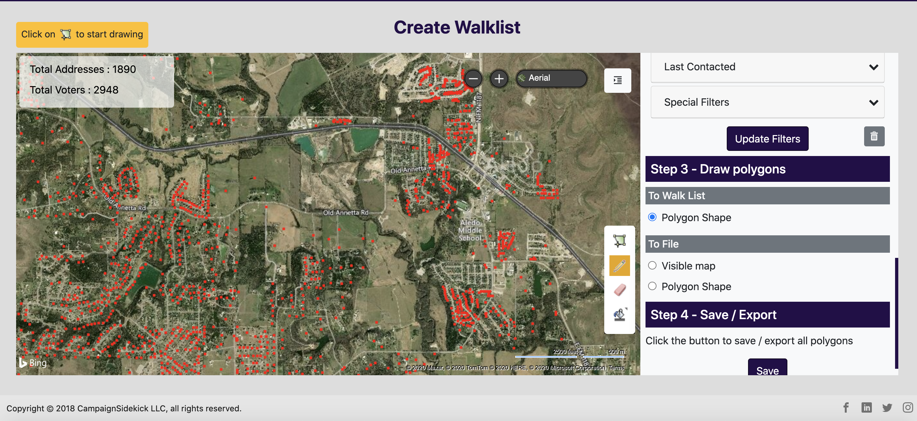
CREATING WALKLISTS
If you want to change the size of your polygon, first click the Pencil icon, then the polygon you wish to edit.
You will see white dots appear on the corners of the polygon. Using those, you can now make your walklist larger or smaller.

Slide 15
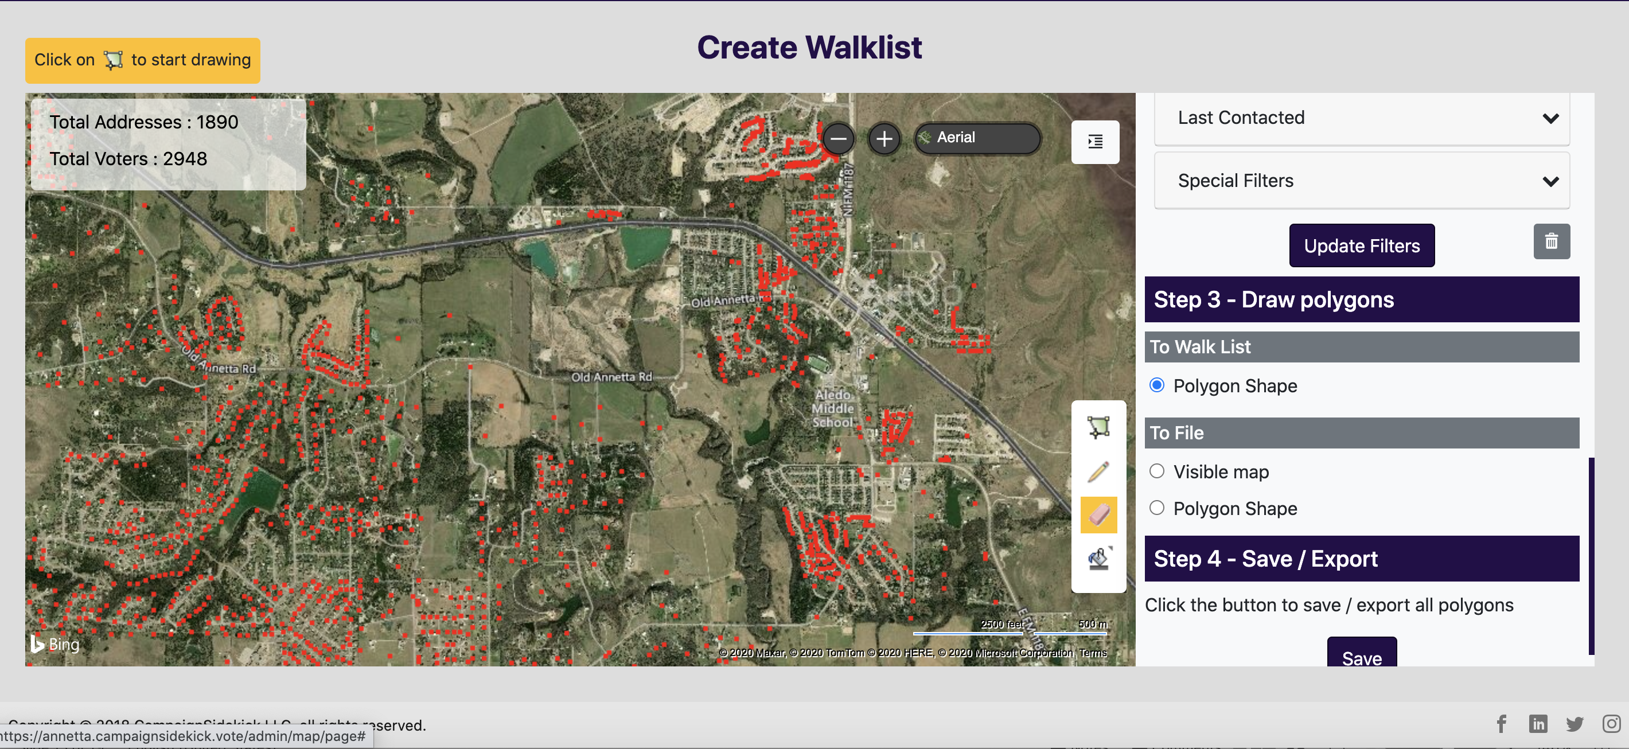
CREATING WALKLISTS
If you wish to erase your polygon shape and start over, first click on the Eraser icon, then the polygon you wish to erase and it will disappear and you may start the process over.

Slide 16
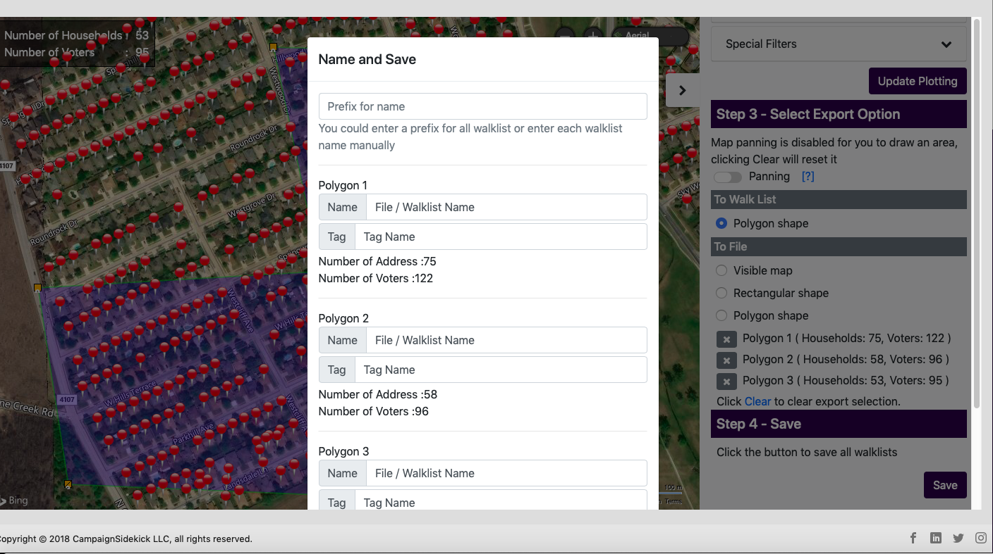
CREATING WALKLISTS
Once you have saved your walklists, you will be asked to name them. Keep in mind that after 10 lists are created, Sidekick will force you to name them and either optimize (under 25 homes) or manage (26-150 homes) your lists. You can use the Prefix for Name at the top of the “Name and Save” box. The system will number your lists for you!
Notes:
Name the walklist by typing a name in the top text area. This will populate the typed name with a numerical suffix for all of the walklists. They can be manually edited by changing text in the “Name” field for each list.

Slide 17
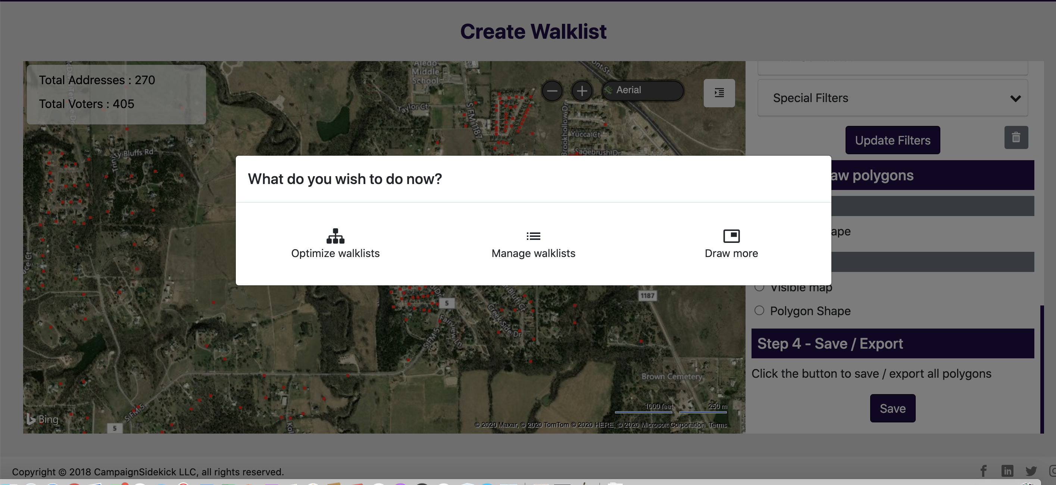
CREATING WALKLISTS
You now have three options. You may stay on the map and draw more lists, you may go optimize walklists or manage those lists you just created.
Note that all lists with under 25 homes will be found in “Optimize Walklists” and those will 26 homes up to 150 will be found in “Manage Walklists.”
Notes:
After hitting save, you can either select “export and draw more walklist” to return to the map view and continue cutting lists (with all of your filters still remaining set) or you can go to the walklist optimization page by clicking “Export and optimize walklist.” Clicking “Cancel” will take you back to the map view and allow you to make further edits to your walklist polygons.
Upon clicking an export option, walklists of 50 or less houses will move to the Optimize Walklist page while lists of 51-150 will be found as unassigned walklists under the Manage Walklist page.

Slide 18
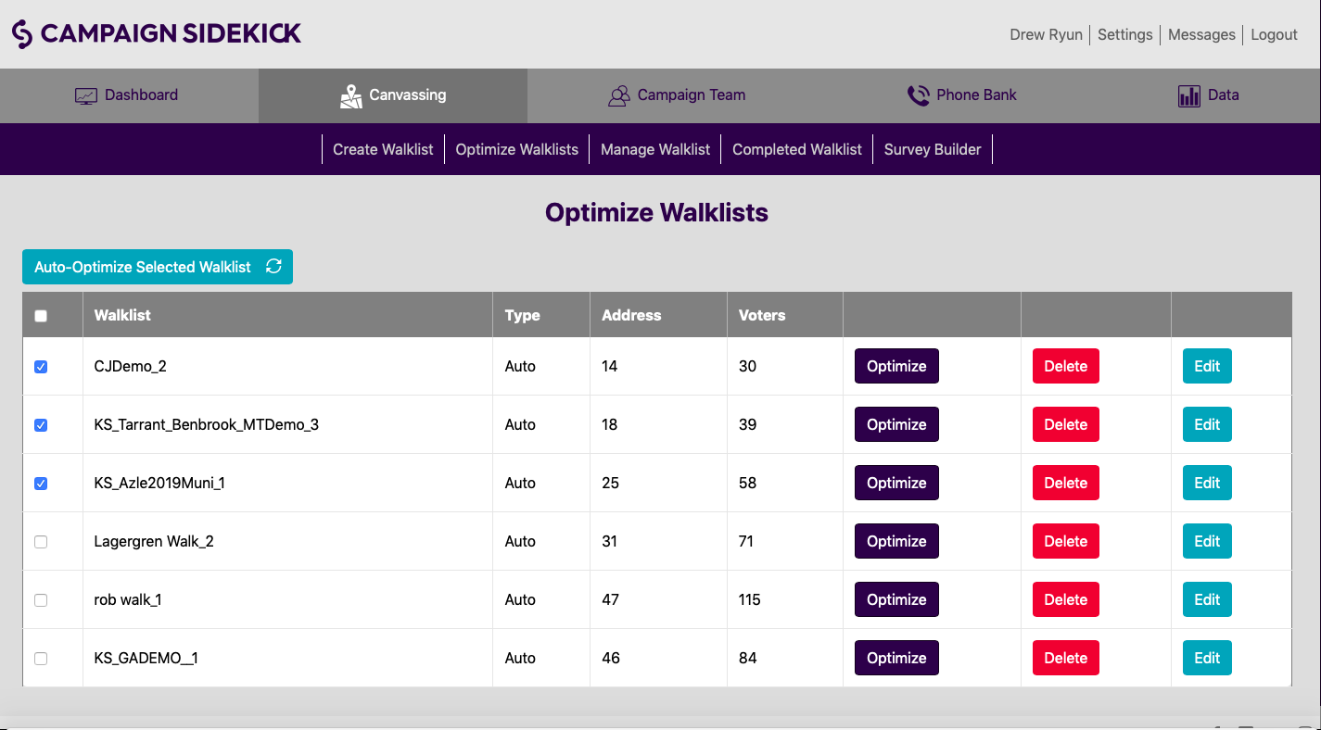
CREATING WALKLISTS: Optimizing
If you have a queue filled with lists under 25 homes, you may Auto-Optimize them all at the same time. Allow for Pop Ups on your computer, then select the lists you want to optimize, then hit “Auto-Optimize Selected Walklist.” The Sidekick system will take it from there and you will now find those lists in “Manage Walklist.” Depending on the number you optimize, allow 15-30 minutes!
Notes:
Auto-optimizing walklists is a great way to rapidly route 50 or less house lists. You’re able to get it started and then walk away from your computer while it does the work. It should be noted that this function assumes two things, when routing: You want a round-trip walklist and you don’t care where your starting point is. Most walkers prefer round-trip lists (think parking and returning to their car) and if this is the route type, the start position doesn’t make much difference.
Make sure that you have allowed Pop-ups. If you haven’t, then even when trying to auto-optimize, only one list will route. If it seems like the process has aborted after one list, check your pop-up settings and try again.
Lists typically take 2-5 minutes each for the computer to route.

Slide 19
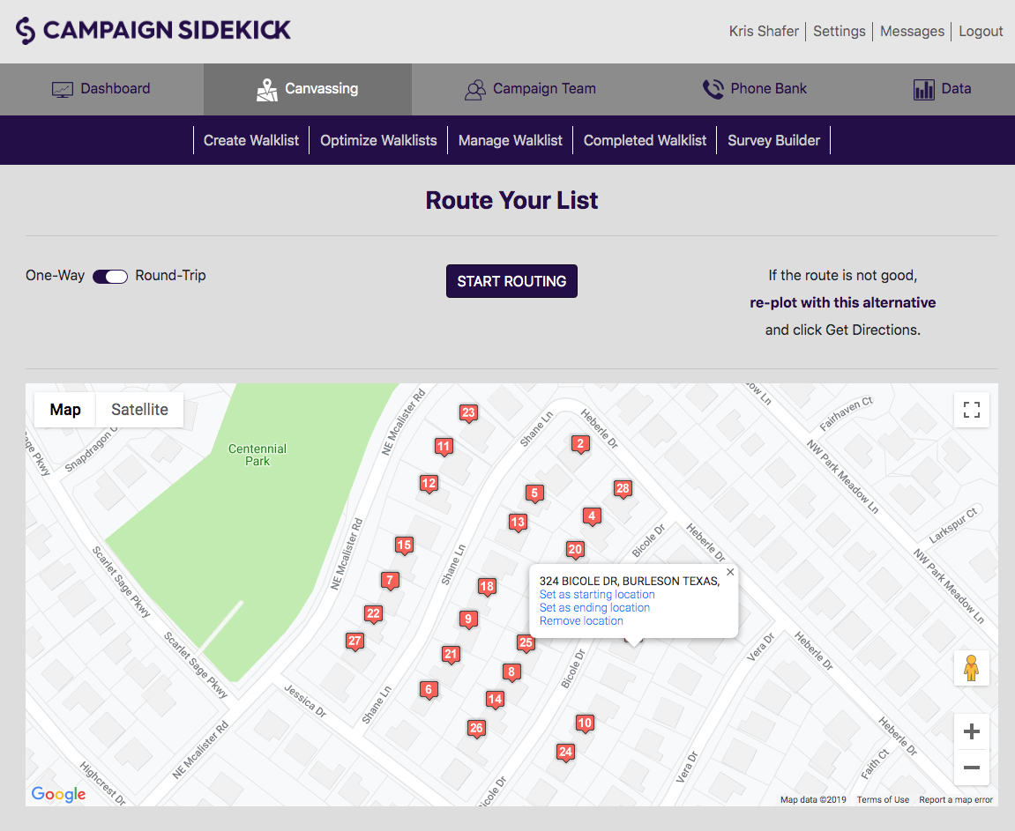
CREATING WALKLISTS: Optimizing
If you’re not interested in Auto-Optimizing your routed lists, you can individually optimize them as well.
To do this, instead of check-boxing multiple lists, click the purple Optimize option on the Optimize Walklist page.
Once loaded, you’ll need to decide which type of route you want and select starting and ending points as needed.
When ready, click Start routing.
Upon completion of routing, you’ll be able to review the route and make edits, if you so desire.
Notes:
Once you’ve loaded the optimization screen for a list, first decide whether you want to do a one way or round trip route. The toggle in the top-left of the screen will allow you to determine this. Round-Trip is selected by default.
The numbers assigned to the household flags on the map are randomly assigned, so if you click “Start Routing” it will assume the number 1 house is where you want to start. If you have another starting point in mind, click the house you want to be your starting point and then select “Set as Starting Location.” This house will now be numbered as 1.
In the case that you are doing a one-way route, you’ll also need to assign an ending location by the same means. Not doing so will let the computer believe that whichever house has been randomly assigned the highest number is your ending location. Since the starting and ending points of a round trip route are the same point, you don’t need to select an end point for a round-trip list.
If you wish to remove a house from the list at this stage, you can click “remove location” after clicking on the house you wish to remove.
When your route type and start/end locations are set, click “Start Routing” to initiate the optimization process.
Once completed, you will see a route preview and the addresses listed in route order in a column on the right side of the screen. You can change the order of the houses by drag/drop within this column. The routes are optimized for shortest walk path, so the instances where editing is a good idea are few. However, in cases of difficult terrain or major thoroughfares, you may want to take advantage of this feature.
By scrolling down the preview page, you can see the turn-by-turn directions between houses and see how long the proposed route is.

Slide 20
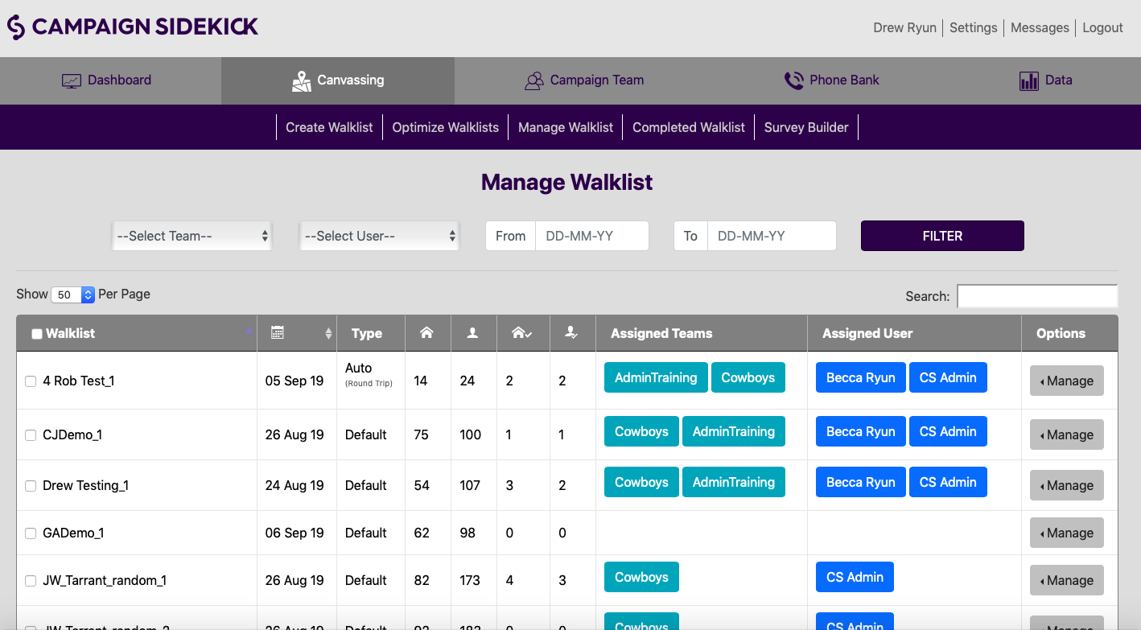
CREATING WALKLISTS: Managing
If you want to change users, teams or surveys on a walklist, go to “Manage Walklist.” Once there, check the box to the left of the walklist you want to edit, scroll to the bottom and edit your teams and users. To change your survey, hit the “Manage” tab on the far right of the queue then use the drop down menu to “Select Survey.”
Notes:
You can select one or more walklists to assign at once via the checkboxes on the left hand side of the screen. Names appearing under the Assigned Teams or Assigned User columns will tell you who the list is currently assigned to.
Once the checkboxes have been selected, scroll to the bottom of the page and enter the team/s or user/s you wish to have access to the list. Then click “Assign” to finalize walklist assignment. This process can be used to assign or reassign lists.
The “Manage” option on the right hand side of the screen can be used to print walklists, reroute a routed list, view a map of the walklist or assign a survey other than the campaign default.

