Slide 1
App/Phonebank/Filter Settings
Notes:
This is for Admin Owners

Slide 2
Settings
To adjust your Sidekick app settings, click on “Settings” in the upper right hand corner of your screen.
Notes:
Several of the app settings can be controlled in the settings tab/

Slide 3
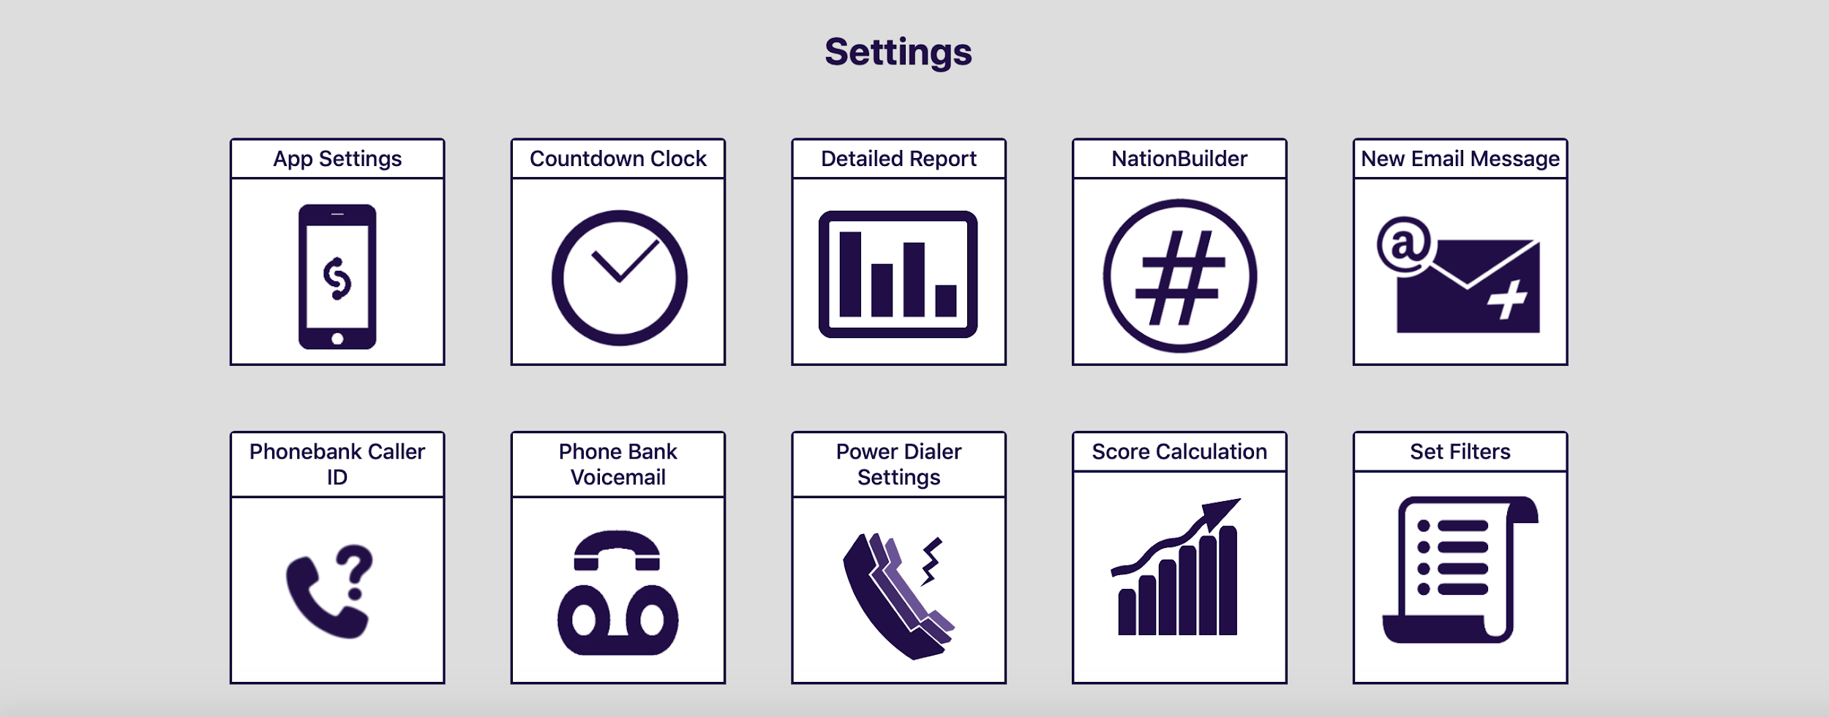
Settings
Once you have done that, you will see Sidekick’s backend settings widgets. Click on “App Settings.”
Notes:
Several of the app settings can be controlled in the settings tab/

Slide 4
App Settings
App Settings currently allows Admins three options: Clock functions, Self-Assign Walklists (tied to Unassigned Walklists in the app) and Offline Walklists. You may choose which functions you would like for your users to have (or not have) with the toggles on the right.
Notes:
Several of the app settings can be controlled in the settings tab.

Slide 5
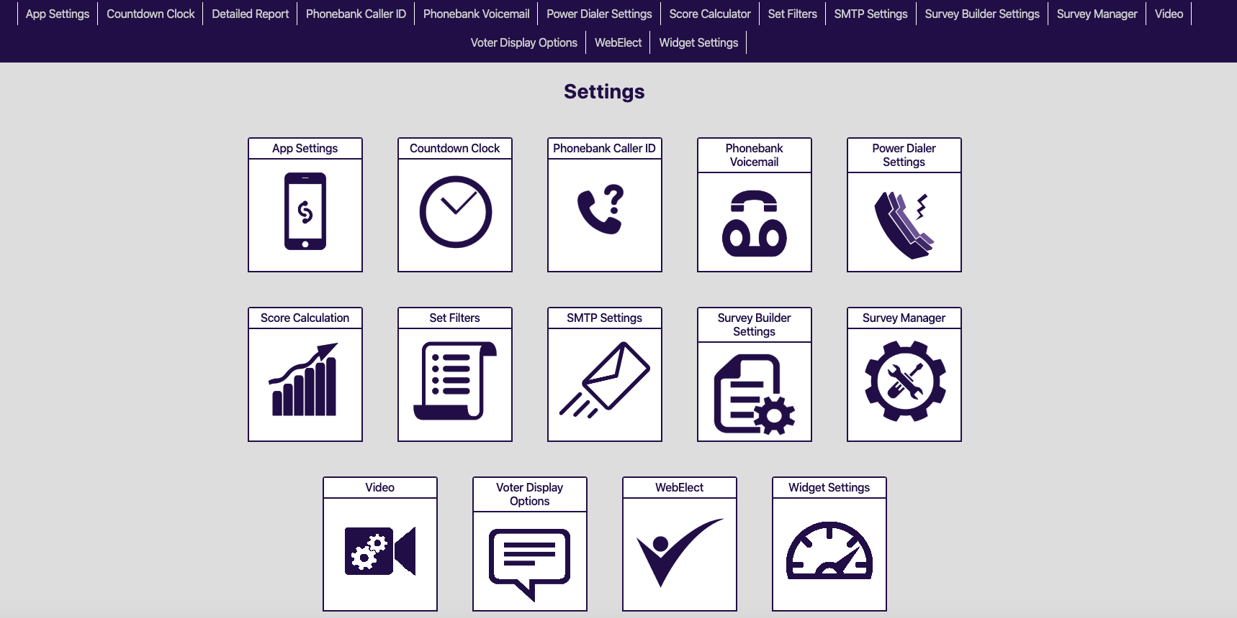
Settings (Phonebank)
You also set up your Phonebank in the Sidekick settings, starting with the Phonebank Caller ID.
Notes:
Several of the app settings can be controlled in the settings tab/

Slide 6
Setting Up Caller ID
To set up your Phonebank Caller ID, enter the phone number. Note it must be an actual phone such as a landline or a cell phone (not Google Voice).
Verify the number
Make it the default caller ID.
Notes:
It’s important to remember that before you start making phone calls. 1) You set up your caller id and make the caller id the default survey.

Slide 7
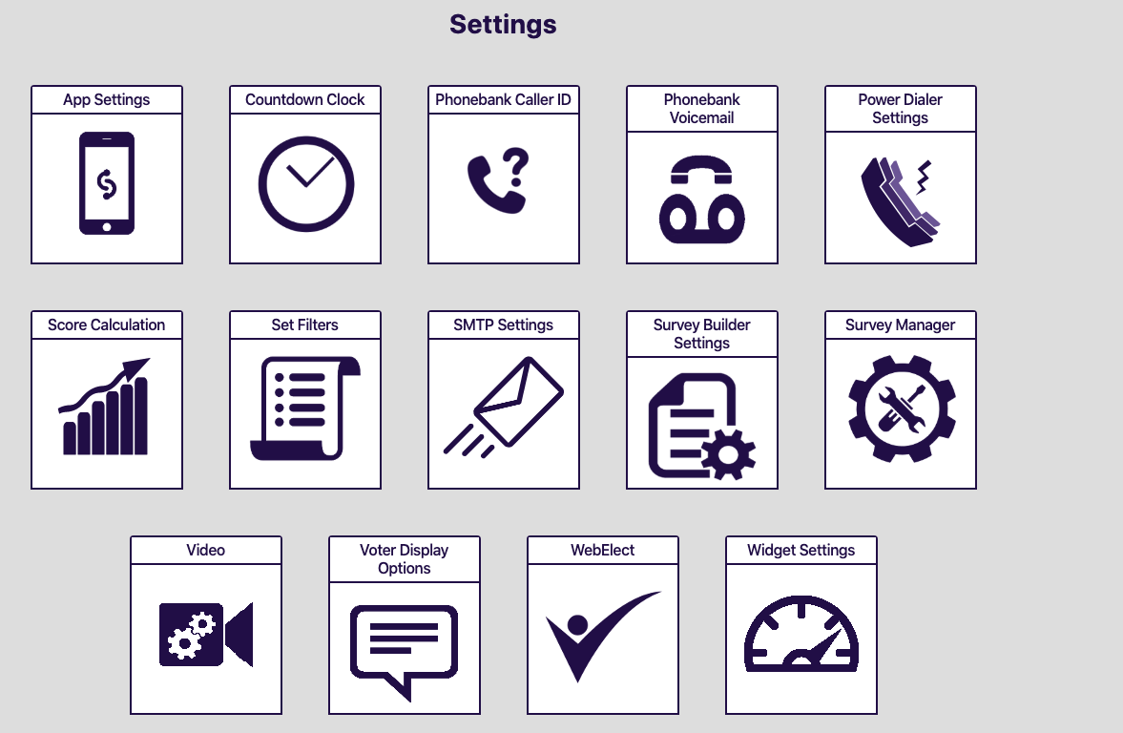
Settings (Phonebank)
Once you have set up your Caller ID, move to Phonebank Voicemail.
Notes:
Several of the app settings can be controlled in the settings tab/

Slide 8
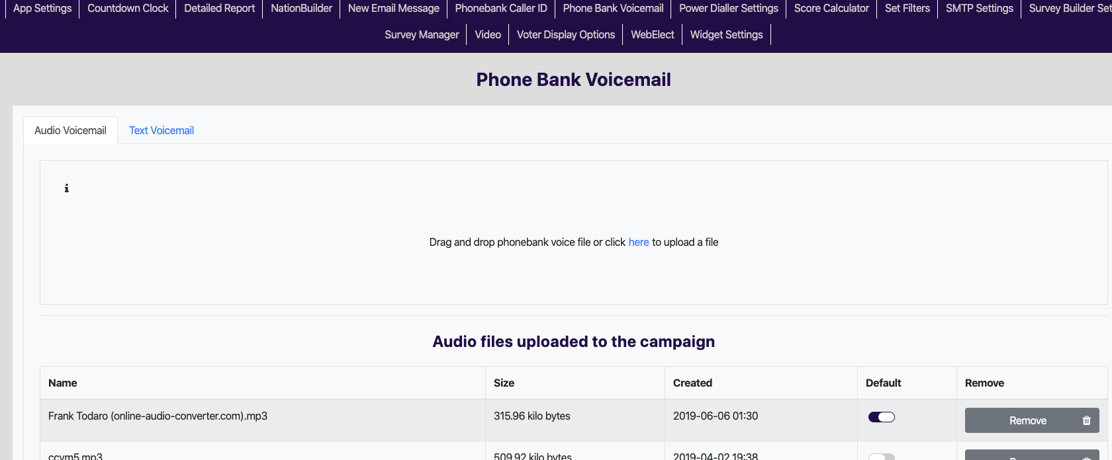
Setting Up Voicemail
Record your voicemail as an MP3
Upload your voicemail by dragging the file or uploading it.
Make it the default voicemail.

Slide 9
Settings (Phonebank)
Once you have set up your Caller ID and Voicemail, you can now set up your Power Dialer ratio.

Slide 10
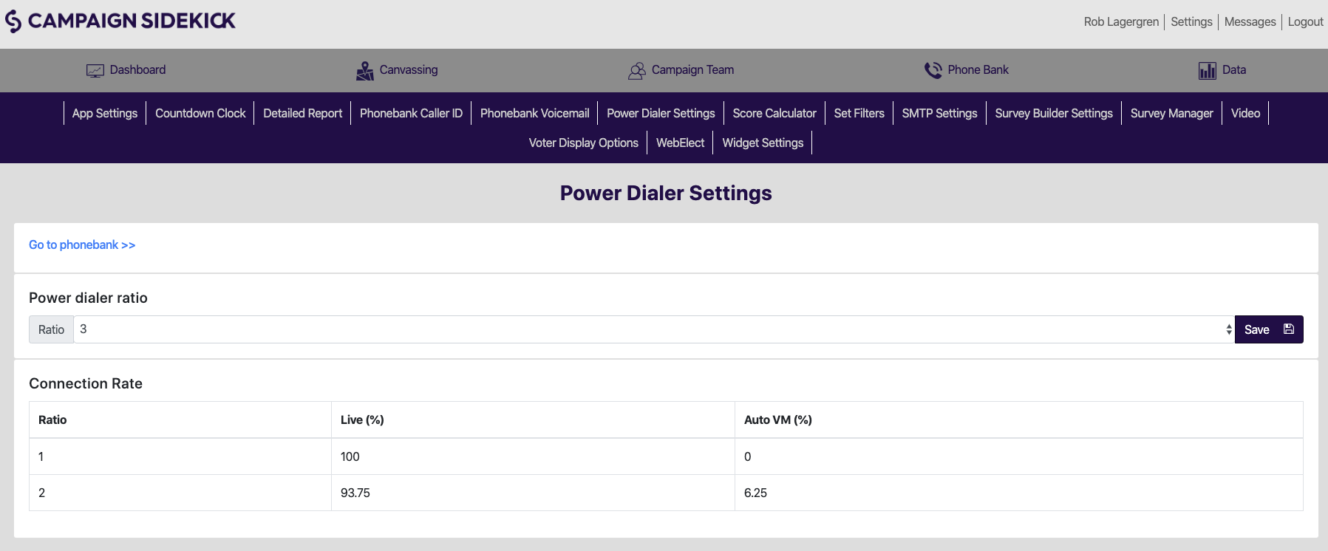
Setting Up the Power Dialer
You may adjust the power dialer from ratios from 1-5 ratio.
Click the ratio that you would like to use. Keep in mind that for higher ratios like 1:4 or 1:5, you will need to have two things: plenty of callers and good phone numbers.
Click “Save.”

Slide 11
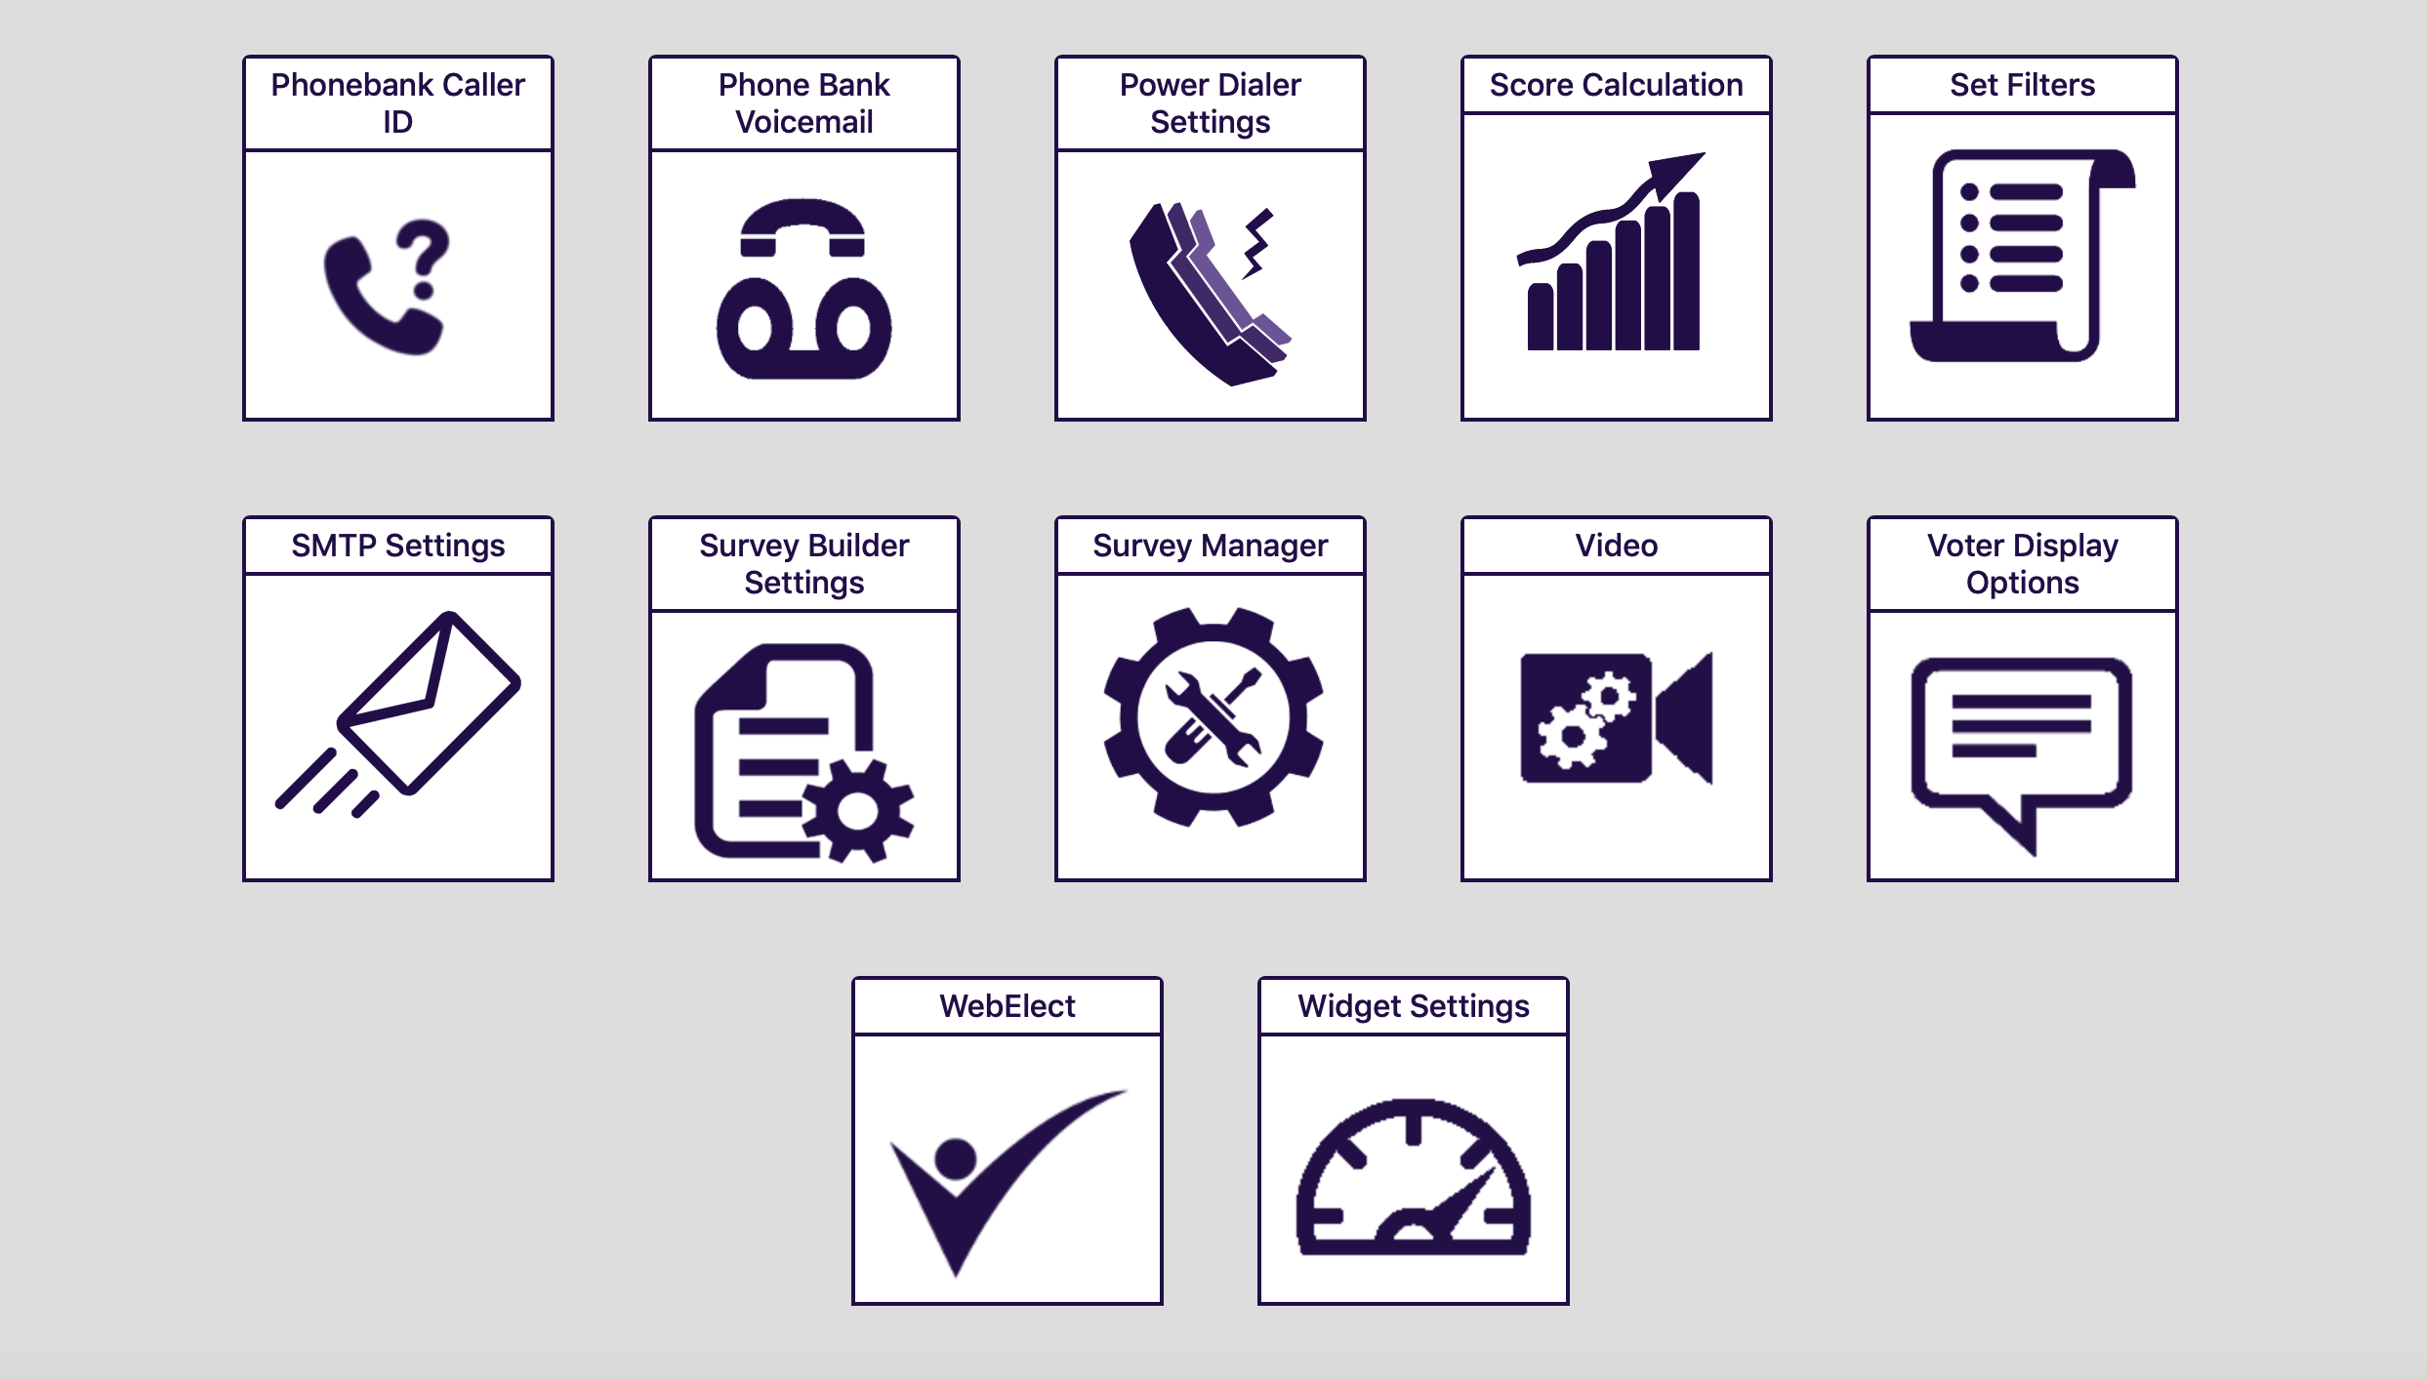
Voter Display
To set up the Voter Display your walkers will see in the app, click on Voter Display Options.

Slide 12
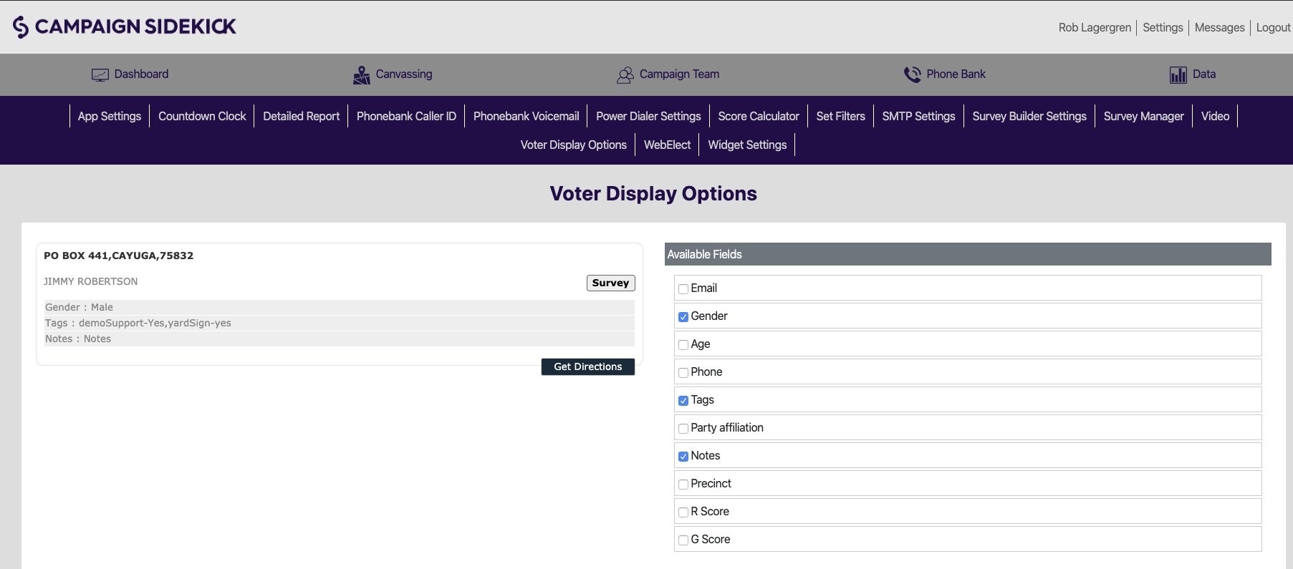
Voter Display Options
You may adjust the Voter Display Options by selecting the criteria you want. Once you have selected your criteria, like Party Affiliation, Gender, etc, you may order that criteria on the left hand side.

Slide 13
Survey Report: Customizing
To view reports by address or by voter toggle on/off the toggle report type.
Notes:
This shows the report by address not by voter

Slide 14
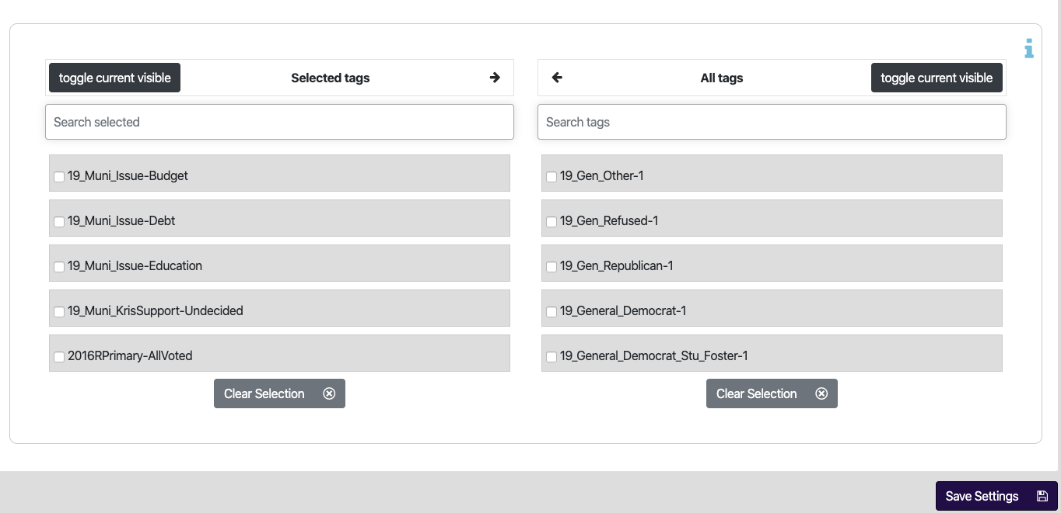
Voter Display Options
Select the tags you would like to be viewed by having them in the selected tags column. Then hit “Save Settings.” You may adjust these Display options at any time.

Slide 15
Set Filters
Did you know you can create very specific universes of voters for your field team to use when they create walklists?

Slide 16
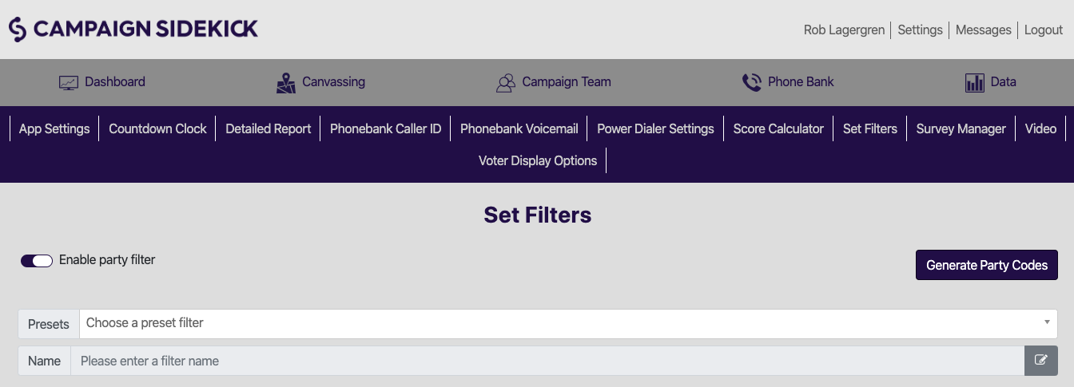
Pre-Set Filters
To set up your filter:
Click on the edit box.
Name your Filter.
Click on the edit box to save your filter name.
Include (or Exclude) your criteria.
Note: You may also include or exclude voters contacted between certain date ranges.
Once you’ve chosen your filters, hit Save.
Notes:
Creating pre-set filters allows lower level users to cut walkbooks within defined universes of voters that administrators and account owners specify. Pre-set filters are used via the Canvassing tab or when creating Phone lists. They are created here through this settings page. You have the same filter options present on the map or phone list creation page but are able to give the filter set a name and save it. This allows the other users to select the named pre-set filter and apply it directly, versus adding each filter criteria. Doing so reduces user error when creating walkbooks and ensures that they use the universes defined by the account administrators.

