Slide 1
Campaign Sidekick Troubleshooting Guide

Slide 2
How to download the Sidekick App
The first step to utilizing Campaign Sidekick is to download the app on your phone or iPad. Iphone and Ipad users can click the link here for instructions on how to download an app. Android users can click here for instructions on downloading an app.
Once you have either the app store open (Iphone) or the Google Play Store open (Android). You will want to search for “Campaign Sidekick”. Please take a look on the next page to see what our app page looks like so that you can ensure that you are downloading our official application.

Slide 3
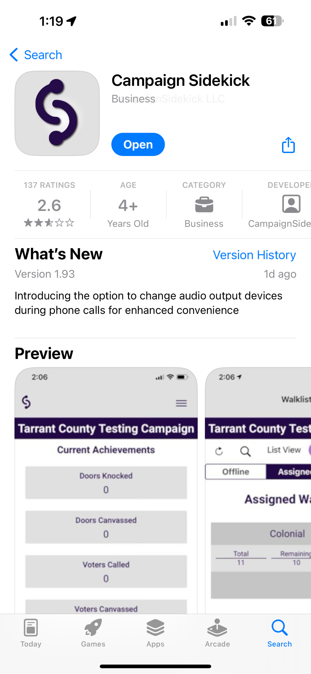
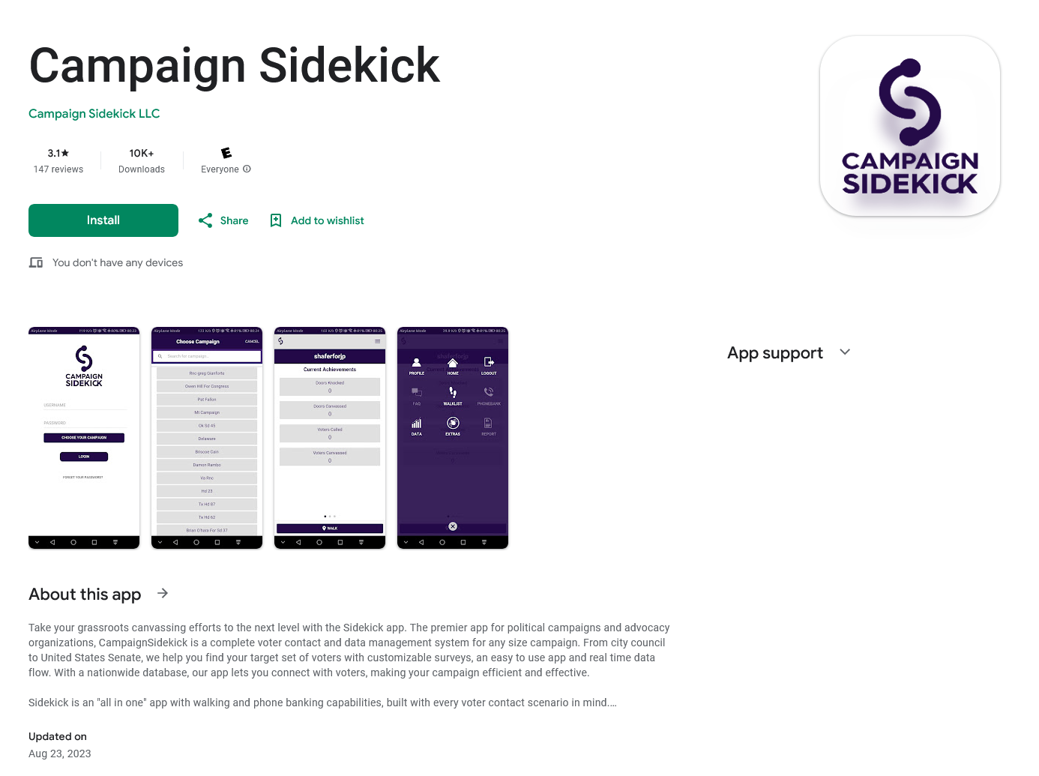
How to download the Sidekick App - App Store and Google Play Store Official Sidekick Pages
Official App Store Campaign Sidekick Page
Official Google Play Store Campaign Sidekick Page

Slide 4
Logging In Common Issues - Username
When logging into the Sidekick app always type in your username, then press “choose your campaign”. If your campaign comes up and you are able to select it then this is an indication that you have typed in your username correctly. If no campaigns display this means your username has been entered incorrectly. Usernames are case sensitive and must be typed in exactly as they are provided. Copy and paste and auto fill features are not recommended.

Slide 5

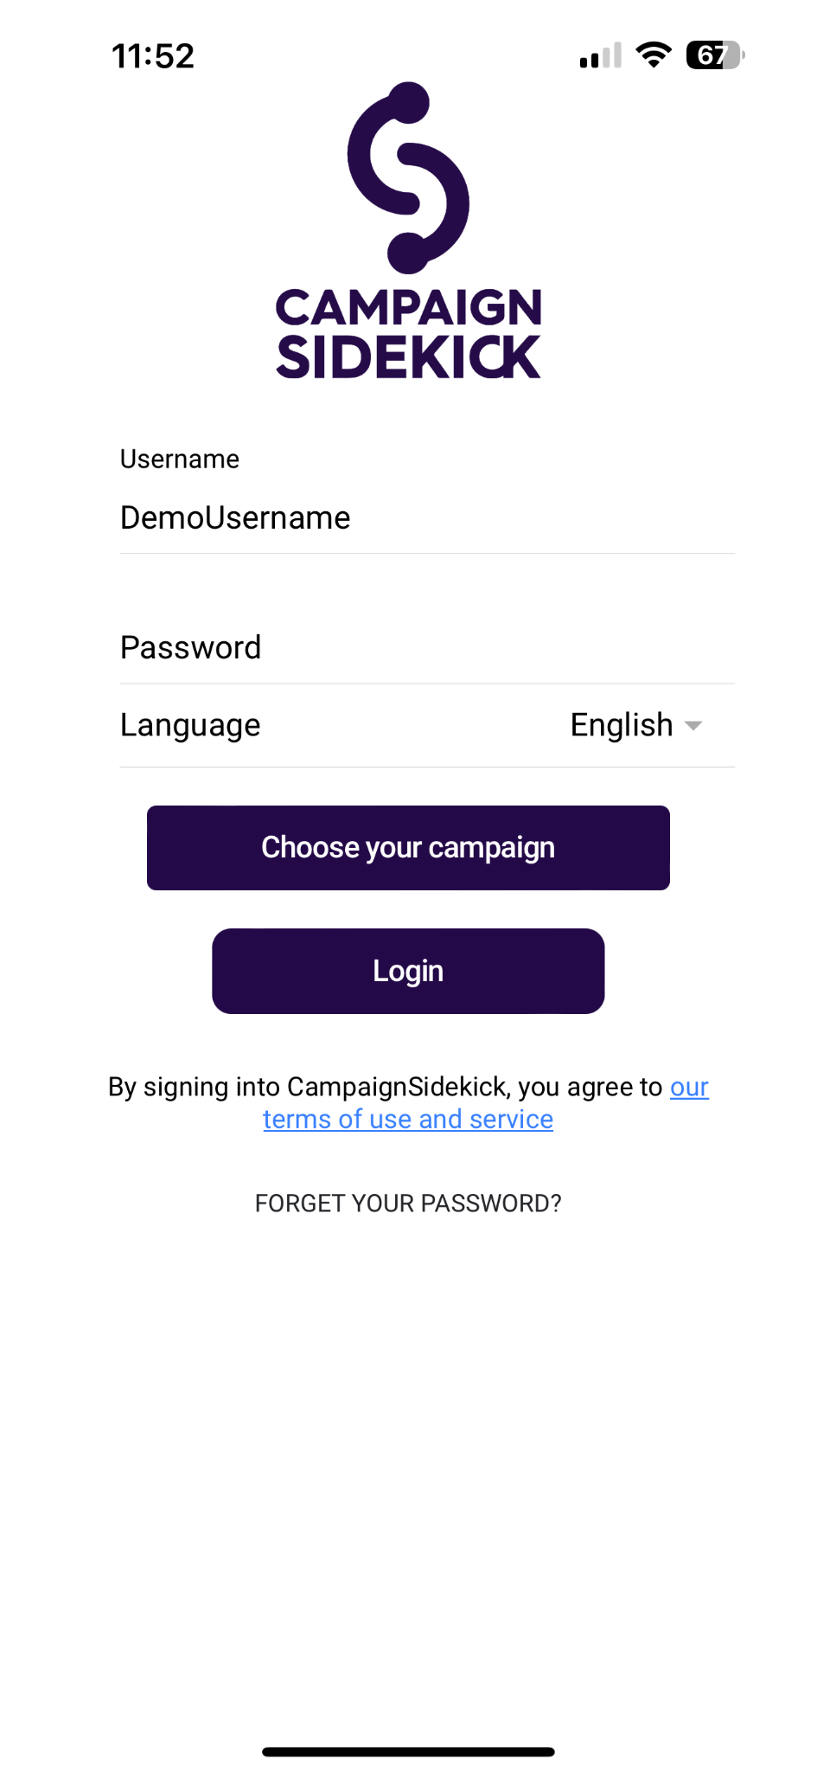
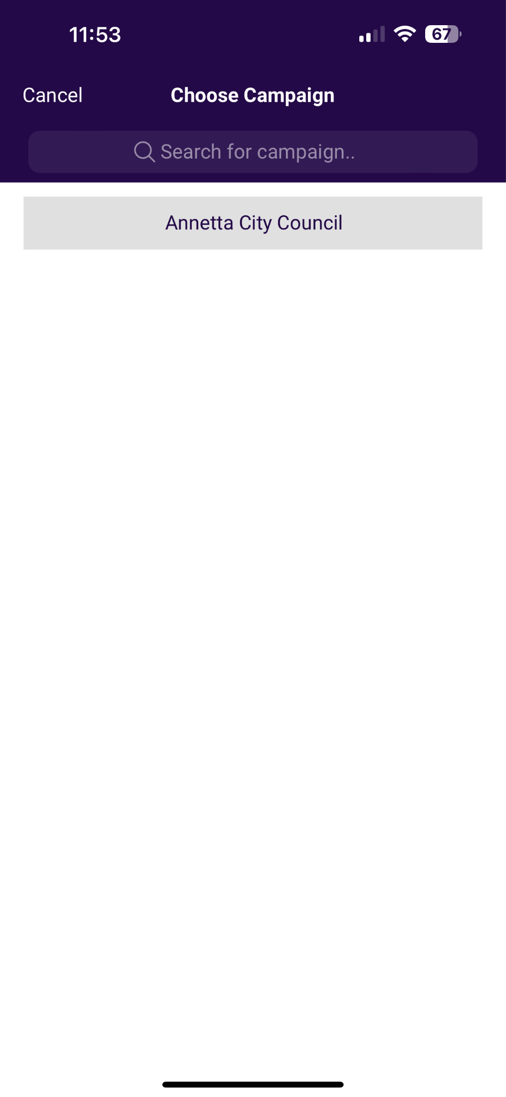
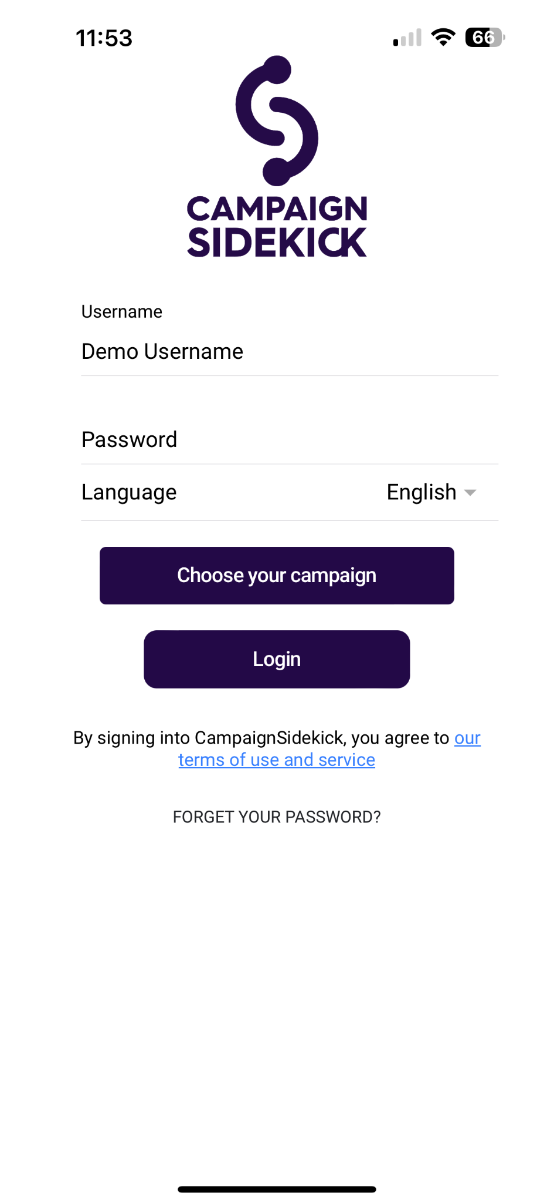
Logging In Common Issues - Username Examples
Below are two examples, one where the username is typed incorrectly and the other where it is typed correctly.
Example 1: Username is incorrect no campaigns are displaying
Example 2: Username is typed correctly. A campaign displays.

Slide 6
Logging In Common Issues - Password
After verifying that you are using the correct username and choosing your campaign you will then type in your password and press “Submit”. If your password is incorrect you will get a red warning at the bottom of the screen that says “Username And/Or Password is Invalid”. To reset your password you will select “Forget your Password?” neat the bottom of the page. You will then need to type in your username, email address, select your campaign and press submit. If this process does not work please reach out to an administrator on your campaign to request a manual password reset.

Slide 7
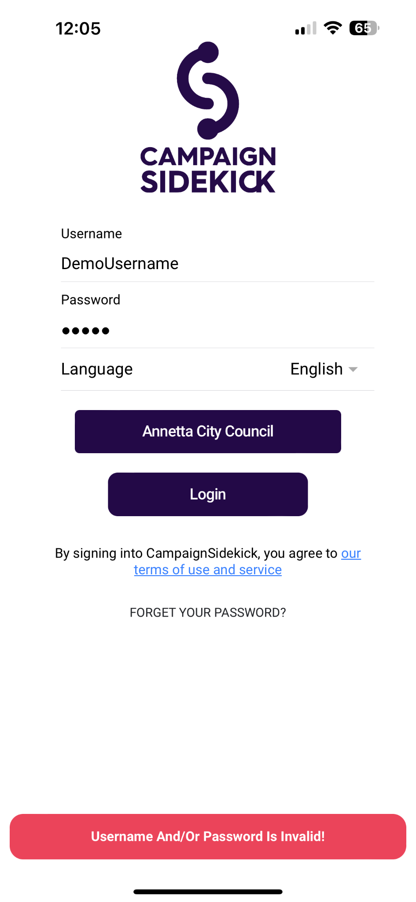
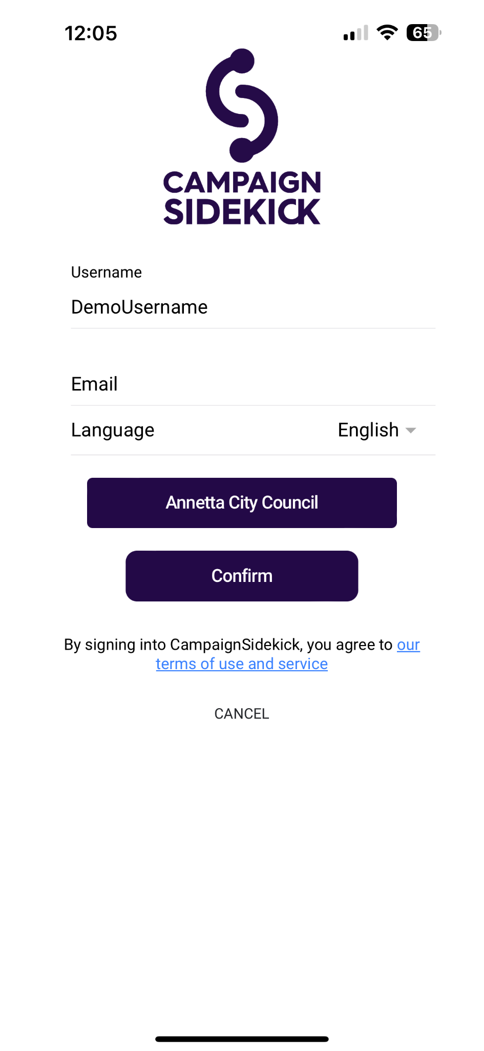
Logging In Common Issues - Password Examples
Below is an example of the password reset process.
Type in Username and Email then choose your campaign. Press confirm, after pressing confirm you will receive an email with the final steps.
Select “Forget Your Password?” here.

Slide 8
Sidekick App Troubleshooting Tips
If, when using Sidekick, you encounter issues such as long loading times, issues knocking doors, walklists not appearing, not hearing outgoing calls, calls not dialing there are some recommended troubleshooting steps.

Slide 9
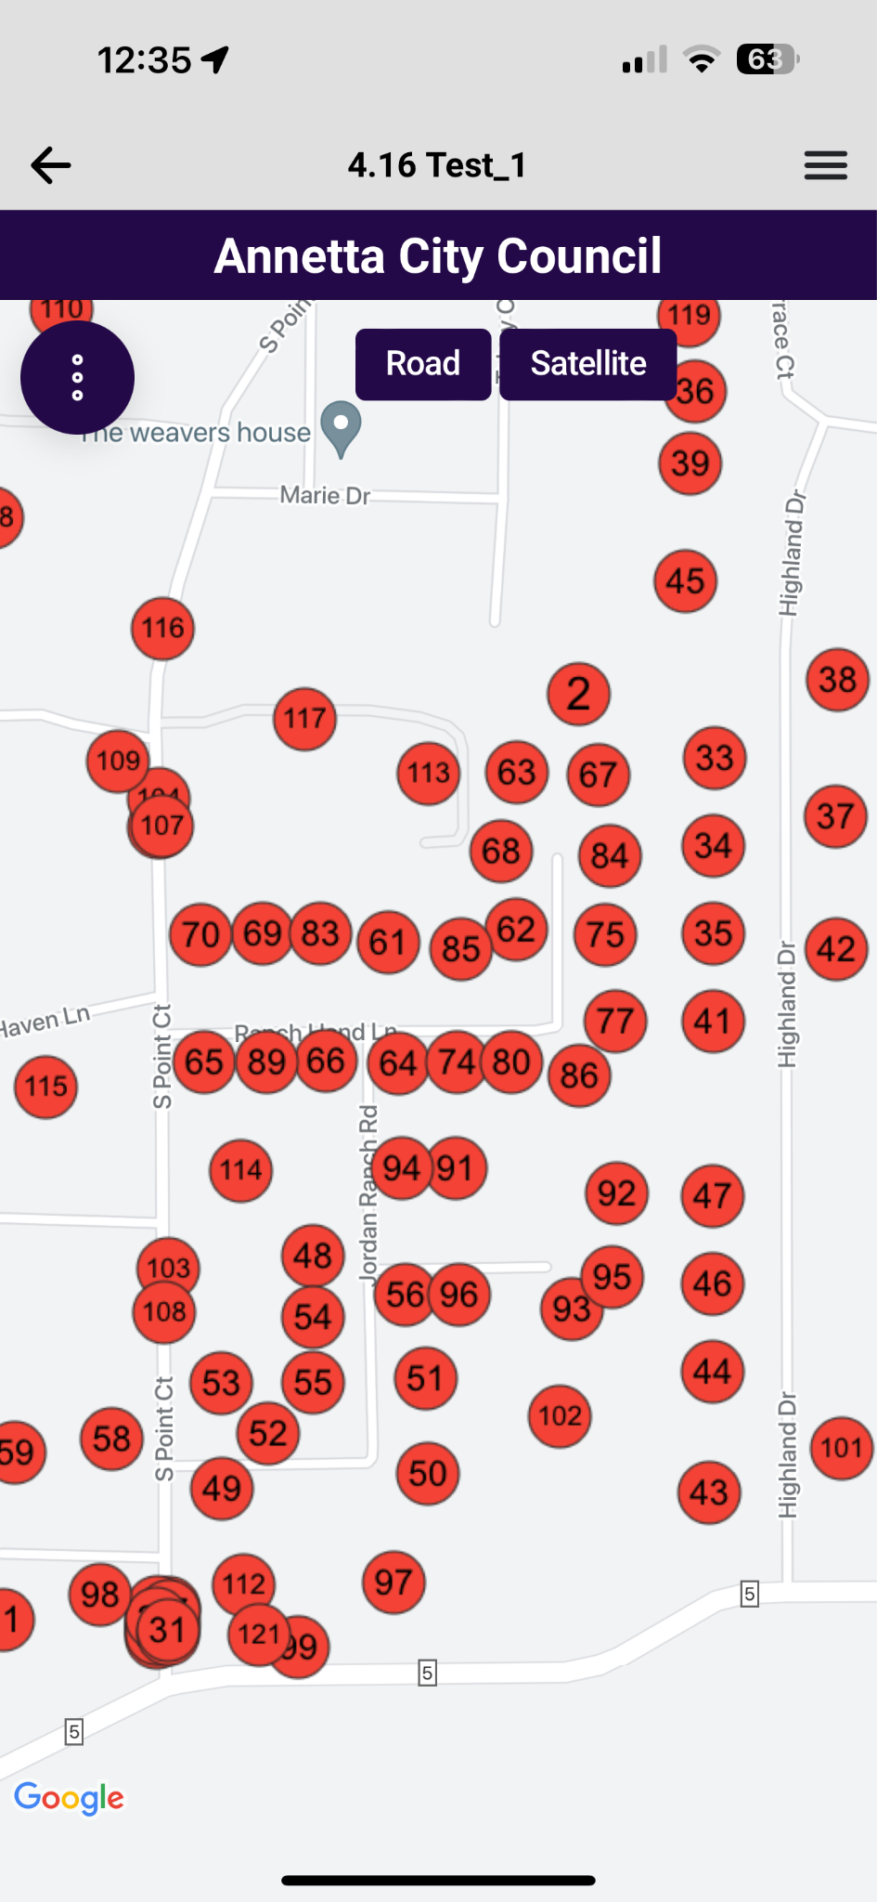
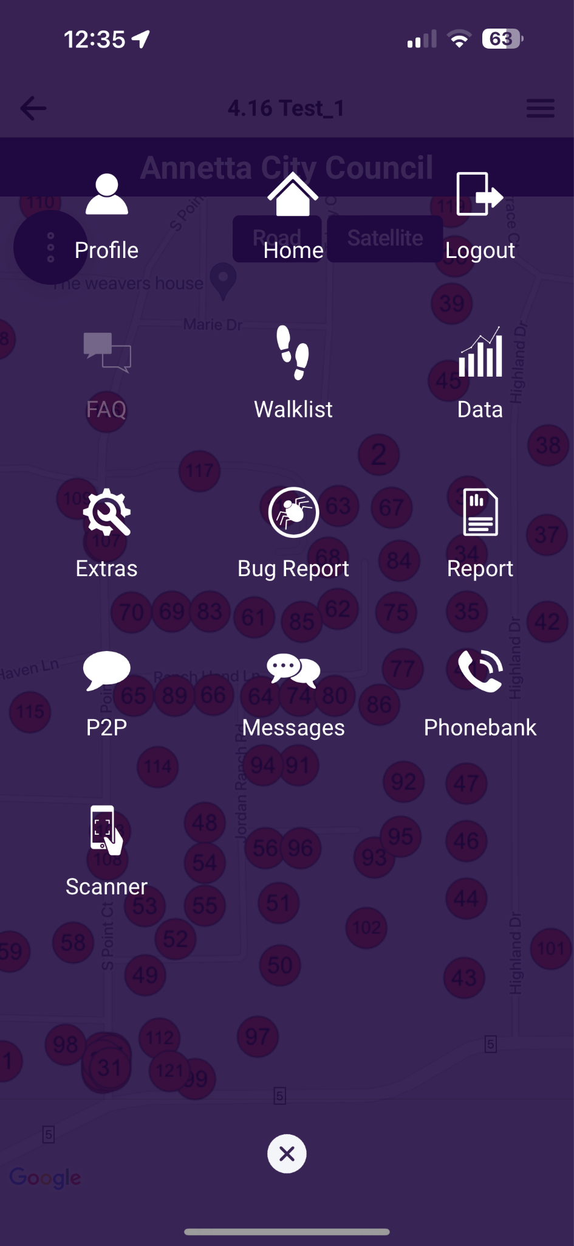
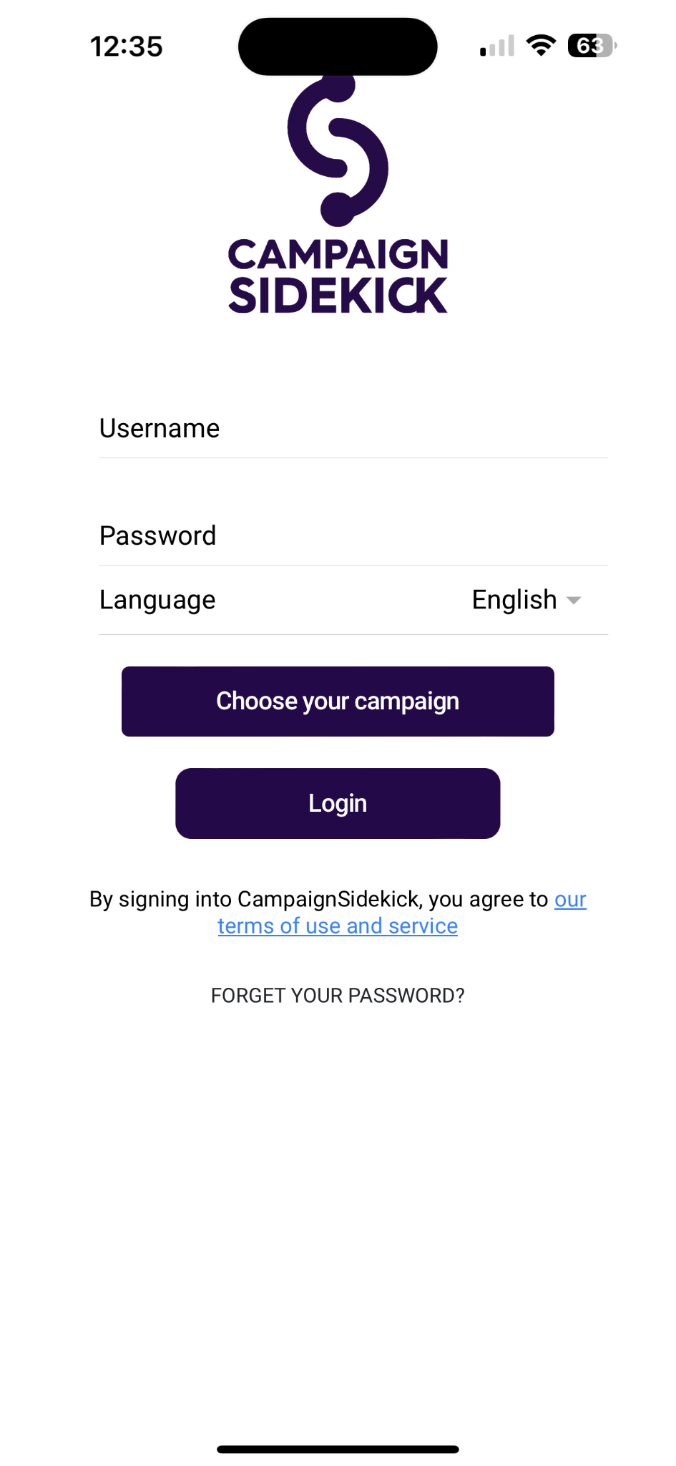
App Troubleshooting Step 1 - Log out/Log in
The first troubleshooting step is to log out and log back in to the app. Below are some images that describe the process.
Press the button that looks like three horizontal lines to go to the main menu.
Press “Logout”
Log back in

Slide 10
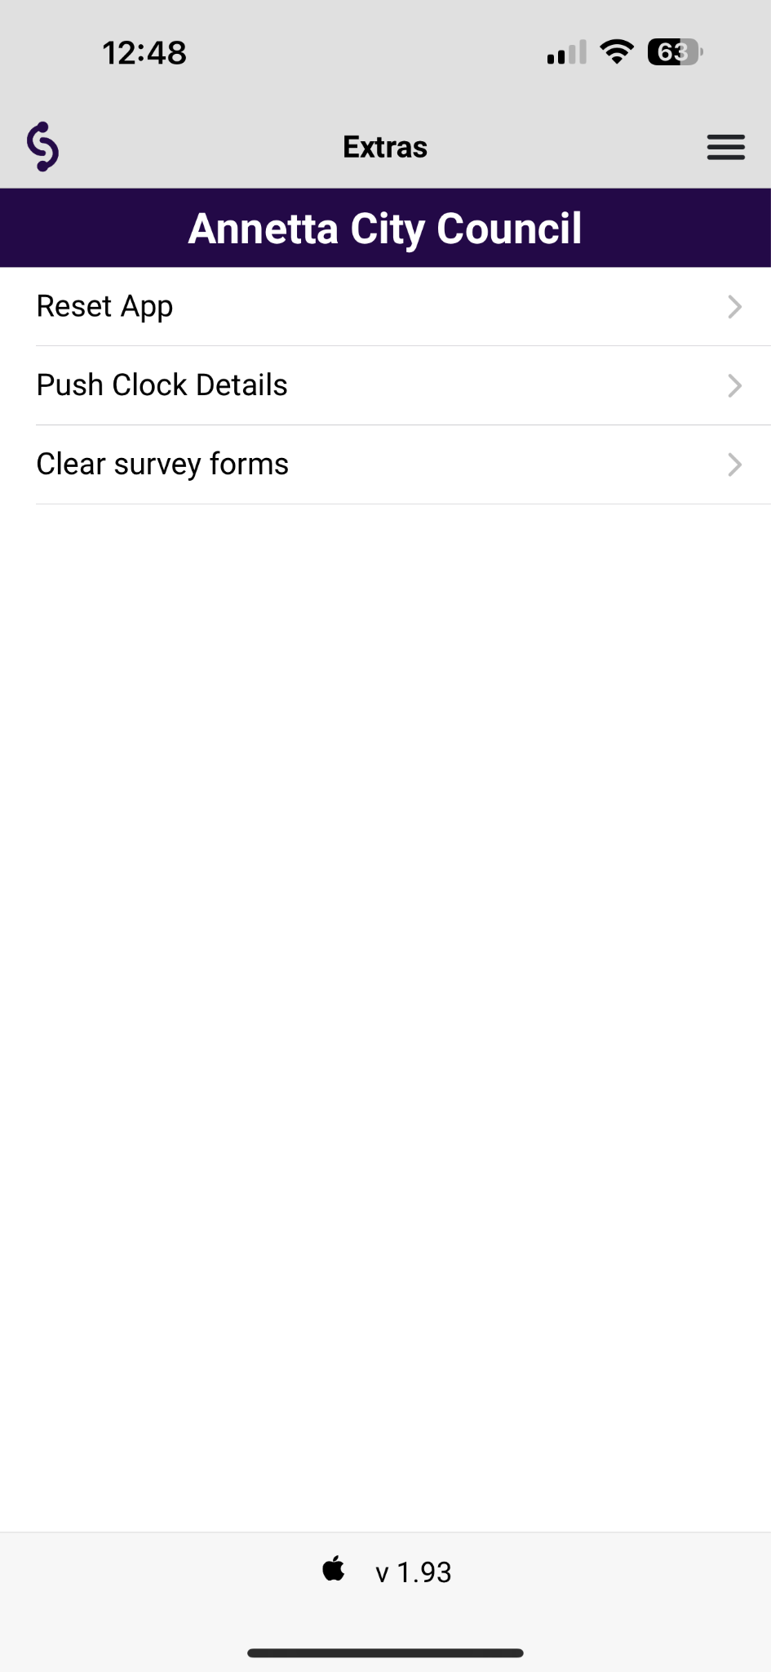
App Troubleshooting Step 2 - Reset App
The second troubleshooting step is to reset the app.
Press the button that looks like three horizontal lines to go to the main menu.
Press “Reset App”
Press “Extras”

Slide 11
App Troubleshooting Step 3 - Close the App Window
The third troubleshooting tip is to close the app window (stop it from running in the background). Iphone users can get additional instructions on how to close the app here and android users can get additional instructions here.

Slide 12
App Troubleshooting Step 4 - Check that the Sidekick App is Up to Date
The fourth troubleshooting step is to ensure that your Campaign Sidekick app is up to date. Iphone users can find instructions on how to update apps here and Android users can find them here.

Slide 13
App Troubleshooting Step 5 - Check your speed
The fifth troubleshooting step is to check your internet speed. If, at this point, the other troubleshooting steps have no resolved your issue then speed is likely the problem. To run a speed test all you have to do is click this link speedtest.net and press the “Go” button. Our minimum required speed is 25 mbps download and 1 mbps upload. If your speed falls below our minimum you will need to wait until your speed improves to continue using the app. If speed problems are common for you please ask your campaign about utilizing offline walklists.

Slide 14
App Troubleshooting Step 6 - Restart your phone
The sixth troubleshooting step is to restart your phone. Iphone users can find instruction on how to restart their phone here and Android users can find them here.

Slide 15
App Troubleshooting Step 7 - Uninstall and Reinstall Campaign Sidekick
The final troubleshooting step is to uninstall and reinstall Campaign Sidekick. Iphone users can click here for instructions on how to uninstall an app and Android users can click here for instructions on uninstalling an app. To reinstall an app, please refer to slide 3 of this of this slideshow.

Slide 16
Phonebank Troubleshooting Desktop
The Campaign Sidekick phone bank is simple and easy to use. To begin calling you will click the “Ready” button, it will begin dialing, and once you are connected with a voter you will click the appropriate button (Ex: Survey, DND, VM, etc.).

Slide 17
Phonebank Troubleshooting Desktop - Allowing Microphone Permissions
To use the Sidekick phone bank you will need to allow Sidekick permission to your microphone. On most browsers you will be prompted to allow permission when you begin calling. If you accidentally decline permission you will need to go into your browser settings and allow microphone permissions manually. On the next page I will describe how this can be done.

Slide 18
Phonebank Troubleshooting Desktop - Allowing Microphone Permissions
Manually allowing microphone access using Google Chrome:
Open Chrome Chrome.
At the top right, click then “settings”.
Click Privacy and security Site Settings Microphone
Scroll down and check that (example.campaignsidekick.vote) is not listed under “Not allowed to use your microphone”. If it is, click the then scroll down to “Microphone” and change from “Block” to “Allow”
Below are links you can click to get instructions on how to grant microphone permissions on other browsers:
Safari
Firefox
Microsoft Edge

